Slide 1


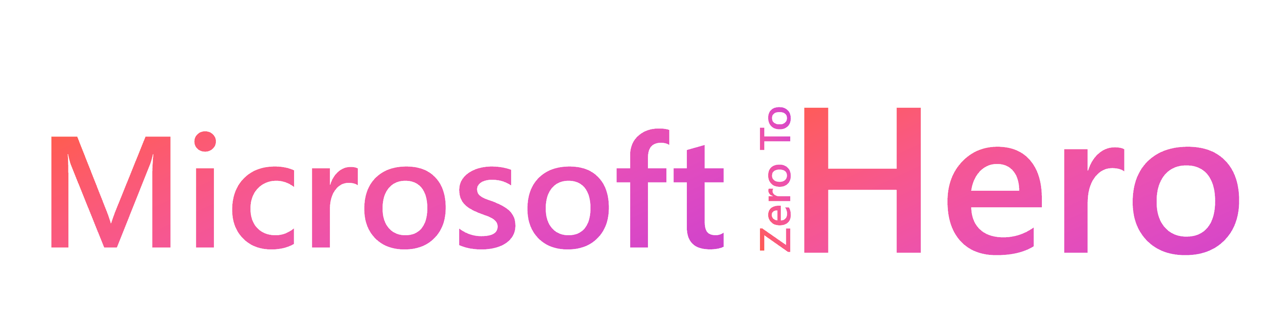
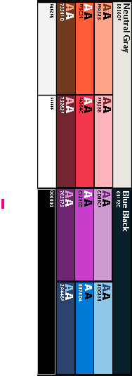



GitHub+Docs+Your Career
William Assaf
Microsoft - Database Docs Team

Slide 2

Agenda
Contribution and your career
Docs Tips and Tricks
Contribute to Docs
How GitHub hosts Microsoft Docs
What’s New in Docs?
Notes:
Have you heard about the Microsoft Learn Community? It's not just a platform for learning; it's a vibrant hub where learners like us come together to connect, engage, and empower each other to achieve our career goals!
(Introducing the overview)
Imagine having the latest updates, news, and the opportunity to join engaging conversations right at your fingertips! That's exactly what you get when you dive into the Microsoft Learn Hub on Tech Community.
Ever wished you could directly connect with experts and fellow learners? Now you can,
thanks to our all-new Learning Rooms! These rooms are designed for interactive discussions, virtual sessions, and skill-building in a diverse and inclusive environment. It's like having a global classroom at your disposal!

Slide 3
Contribution and benefits to your career
Notes:
On the Database Docs team we work with the product groups and program managers for everything SQL Server, including all its various flavors in Azure, as well as Azure Synapse and Microsoft Fabric and the technologies under that umbrella. We also cover content for data platform tooling, like SSMS and Azure Data Studio. And we’re called the Database Docs team because we also cover the open source Azure Database for MySQL, MariaDB, and PostGresQL, as well as Cosmos DB, which thanks to its APIs, is really five or more databases all in one platform.
But we’re just one content team, and today we’re not talking those databases, but rather about all of Microsoft Docs, for all technologies.
Microsoft Docs aren’t Wikipedia, it’s not open to all edits, but we do have hundreds of thousands of articles, and we want to embrace the wisdom of you in the technical user community to help maintain a high level of quality.
Opening the docs up to external contributors is how we scale.

Slide 4
What is DevRel?
Documentation
Introductory thru expert level and reference
Community interaction
Bugs, suggestions, feedback
Technical background
Strategic advantage
Enhance adoption
Technical marketing
Connecting with YOU
Notes:
The Database Docs team is one of many Docs teams for different products in Microsoft’s Cloud + AI DevRel team.
What is DevRel?
In a greater role, Developer Relations ensures that products establish a good, continuous relationship with external developers through mutual communication.
DevRel definitely involves documentation, but also reference documentation for how to call APIs and code samples.
DevRel in other companies might also look like: community management, issue reporting and triage, release notes, focus groups, and public interaction. Your favorite video game for example has DevRel folks to send and receive communication with the public about bug reports, troubleshooting, patch notes, discussion, mods, etc.
DevRel folks are technical and know the products well. In fact, some tech companies cycle developers in and out of DevRel positions so that DevRel folks have a keen awareness of technical detail, but also, so that Developers see how the end user consumes the products and the communication. Content teams like ours across all technologies integrate with product teams, join their support reviews and team meetings, coordinate on release schedules.
Finally, DevRel is a strategic advantage for product teams because this type of outreach enhances adoption and provides authentic community engagement that goes beyond marketing and social media. In a way, DevRel is NOT marketing to CIOs and CEOs, it’s marketing to developers and technical folks like you. There are products out there we’ve all used and continued to use because we had good documentation and support experiences, or because of easy adoption or smooth learning curves.
So in that spirit of authentic community involvement, let’s dive in!

Slide 5
How to contribute to Microsoft Learn content?
Contribute answers to Q&A
Create and share custom Learn Collections
Contribute to open-source Docs on GitHub
Create a Learn plan for others to follow (New!)
Create a custom Cloud Skills Challenge aka.ms/CreateaCSC
Notes:
Let me get your mind going with a bunch of ideas of how to contribute to Learn content, and then we’ll talk about the Learn editor.
Keep these ideas in mind for ways to contribute content and engagement in Microsoft Learn.
All of this contributes to your Microsoft MVP activity report and is looked at qualitatively, not quantitatively.
<click for animation of each bullet>
Contribute to Microsoft Q&A by responding or updating answers with better solutions.
Create and socialize your public Collections in Learn, where you gather up docs, Learn modules, Q&A answers, and external links on a topic. This can then be shared publicly, on social media or your blog, or as possible recommended learning solutions in Microsoft Q&A and other online resources.
This was just introduced, you can create a Plan of existing modules to assemble together Learn modules. For example, the Learn training needed for a given job, project, or certification. You can put together a learning plan, then others can sign up and track their own progress through in-built reporting functionality and emails notifications. As a manager or team lead, you could assign Learn modules and track your team’s progress. Already there are official Microsoft-developed learning plans for a variety of career paths on the Learn site. (https://learn.microsoft.com/training/career-paths/)
Those custom Learn collections or plans you create can become the target for a cloud skills challenge. That new collection on a specific topic can gamify learning with the individual or team goal of completing a custom list of learning material. Cloud skills challenge have a leader board and can be a fun way to challenge your social networks, your customers, or your technical communities to a learning goal.
- Finally, what we’re talking about today, how you’d interact with me and the rest of the database docs team, is contributing via open-source docs on GitHub.
More info: https://learn.microsoft.com/training/support/plans

Slide 6
Why contribute to Docs?
Prevent mistakes with your own lessons learned
Add to NOTEs or CAUTIONs, enhance to samples
Show your manager!
Get your name known to Microsoft content devs, PMs
Your own personal brand, MVP activity
Microsoft spotlight interviews on external contributors
FAQ articles are a great start
Notes:
So, why contribute to Microsoft Docs specifically?
There’s actually quite a few reasons we hope will appeal to your time and effort.
<click for animation of each bullet>
Identify opportunities to improve Docs to prevent common design mistakes and your own lessons learned that would help others.
Add NOTEs and CAUTIONs bubbles, or add or expand on existing sample scripts, perhaps with a helpful comment here or explanation there.
How about more internal benefits for you in your career? By contributing to Docs, you’ll get opportunities to:
Show your manager contributions to your product area and career, perhaps demonstrate leadership in a technical area. If you’re a consultant, show your clients.
Get your name known to the content developers and program managers of your area of expertise, and be a resource to them. We know who our favorite external contributors are through their GitHub contributions, usually by name.
Establish your personal brand for MVP recognition and as a contributor, if not an expert, in your area.
Finally, inside Learn we have a team that has started has a series of contributor spotlights, where we interview both internal and external Docs contributors who have been going above and beyond to contribute to Microsoft Docs, for example

Slide 7
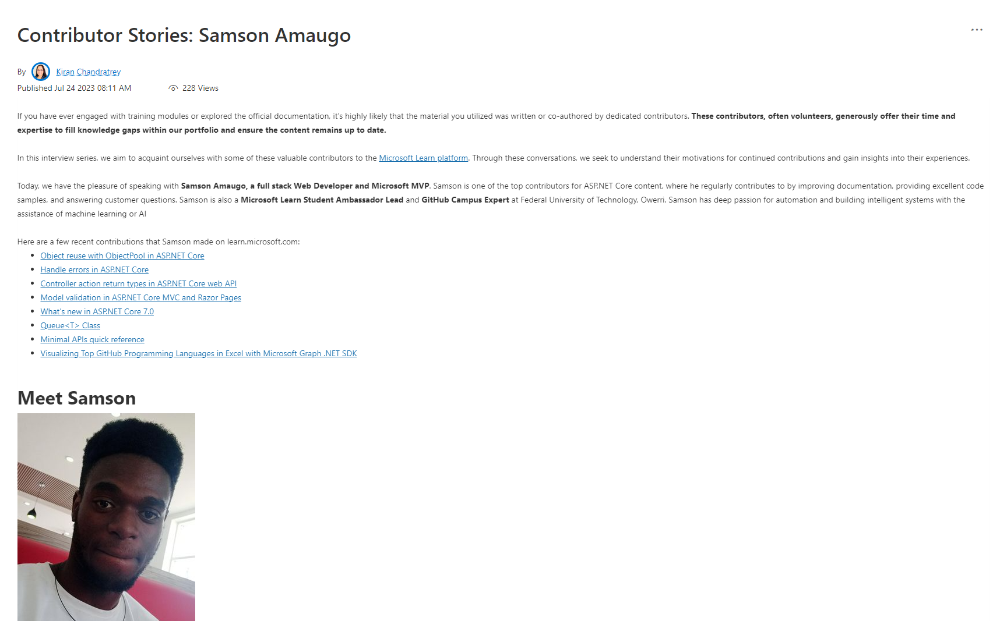
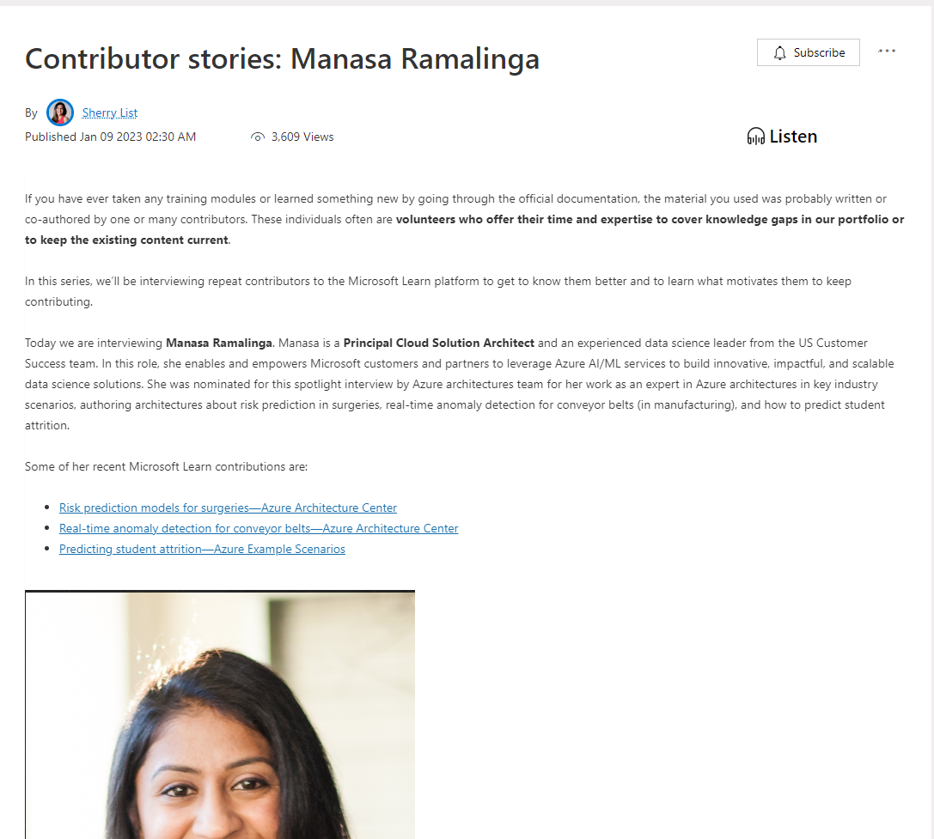
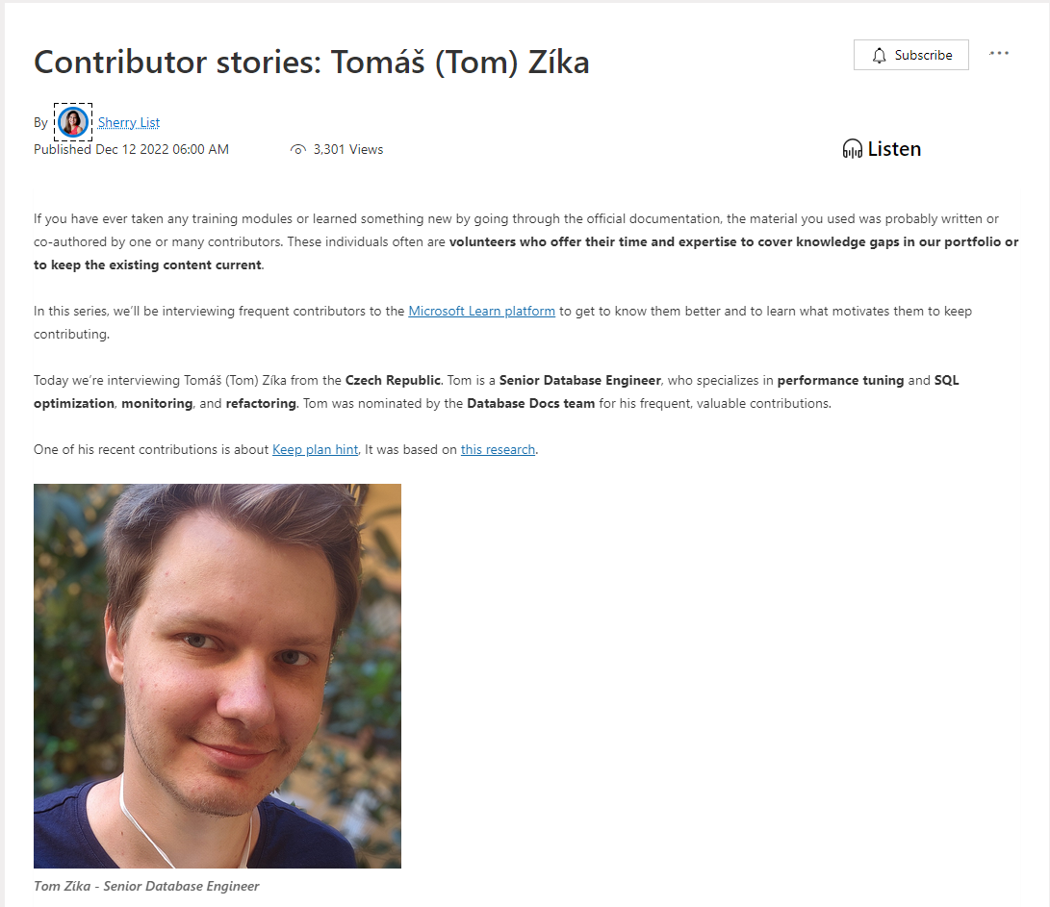
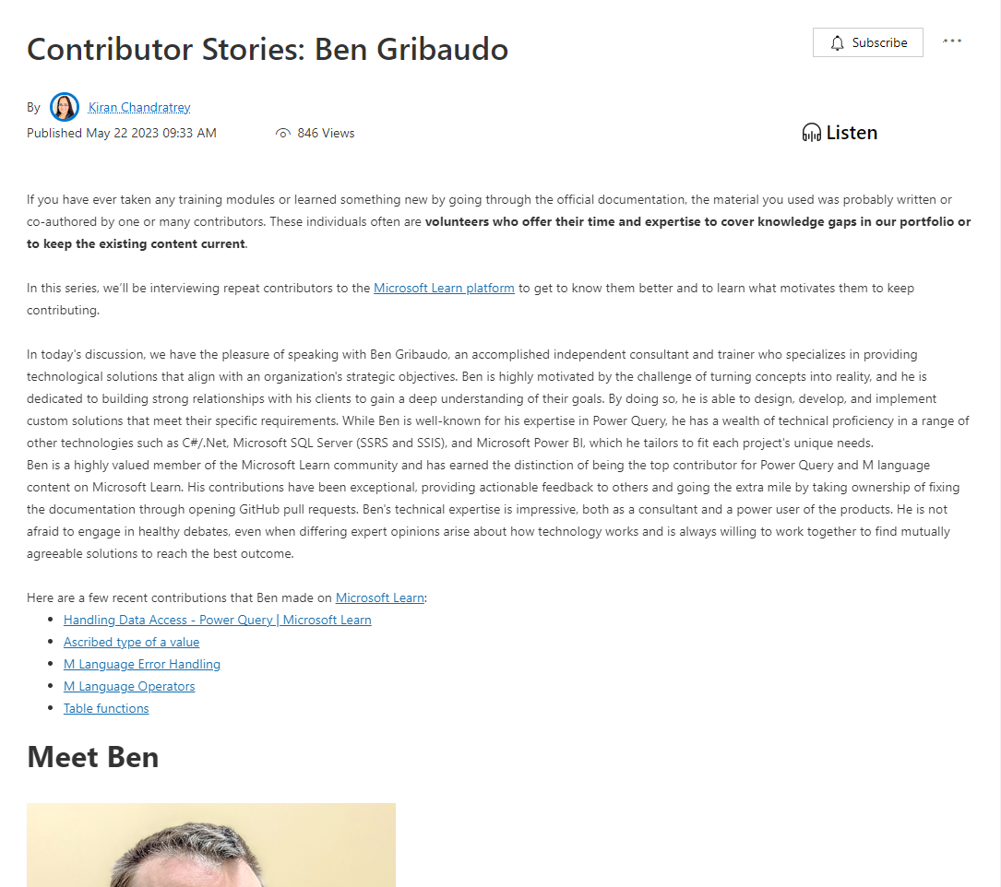
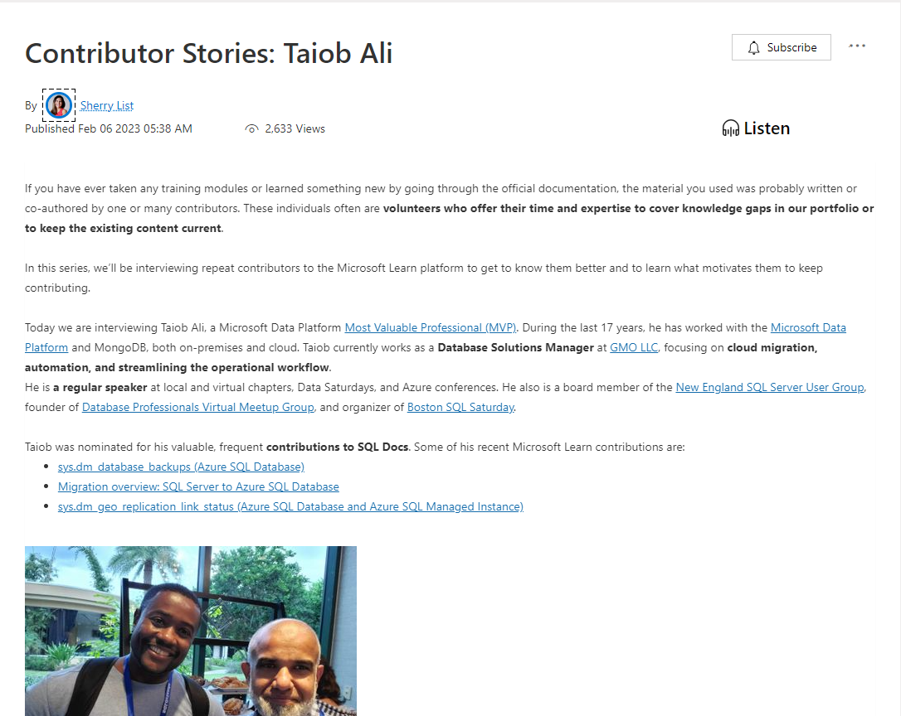
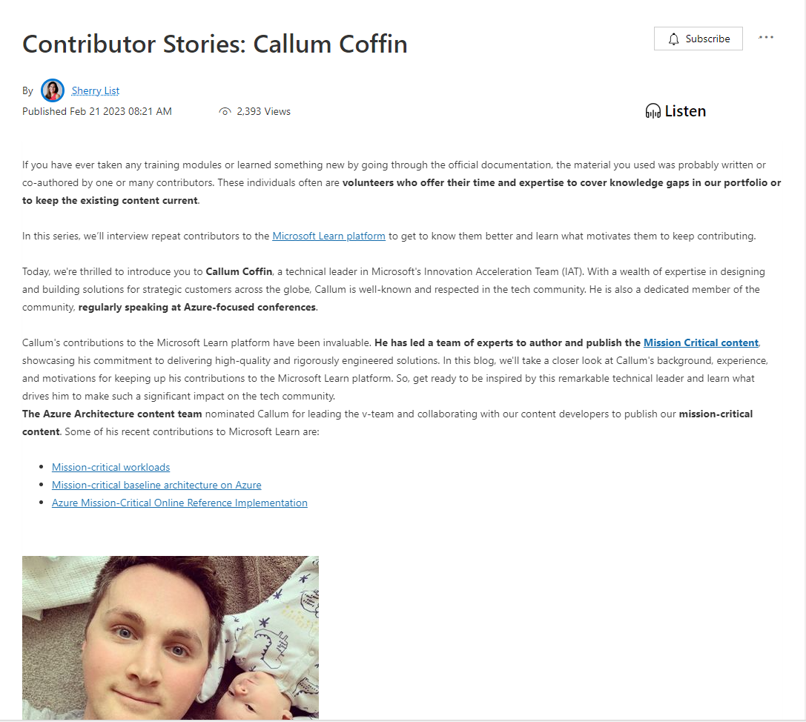
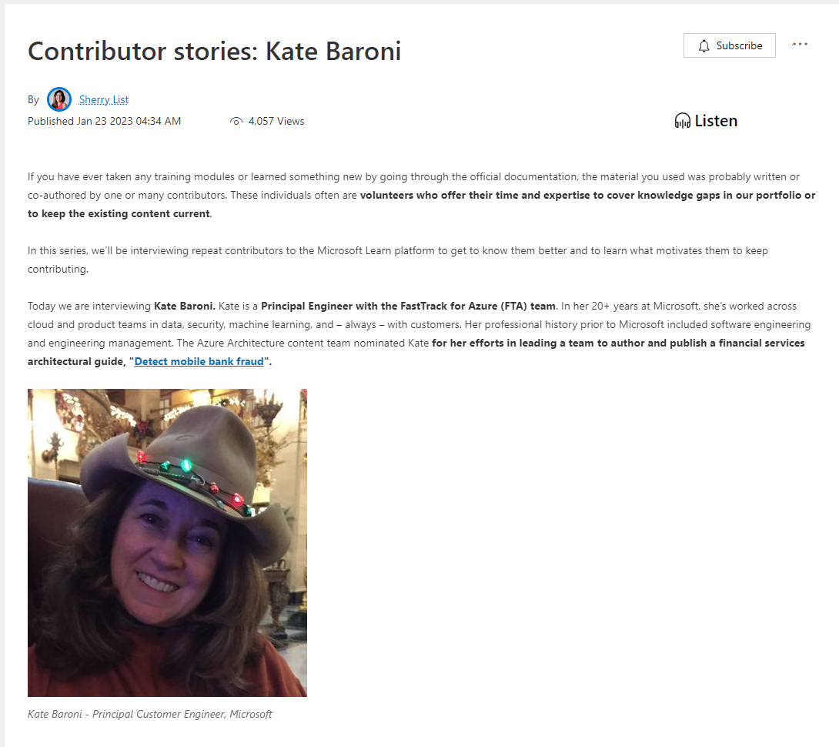
Contributor Spotlights
On the Azure Developer Community Blog
Notes:
In the last slide I mentioned getting your name known.
For more than a year now on the Azure Developer Community Blog, Microsoft has been publishing regular spotlight articles based on interviews with contributors both external to Microsoft, and internal to Microsoft whose primary job responsibilities do not include Docs, for example, escalation engineers or cloud advocates in the field.
These public blogs that are boosted on LinkedIn are just one more way we’ve been encouraging and rewarding Contributions to Learn content. These spotlights are nominated by the Docs teams, the same folks who review and sign off on your contributions. This would be a very nice item to list on your MVP activity report.

Slide 8
Docs Tips & Tricks
Notes:
Alright let’s talk about Microsoft Docs and how you use them.

Slide 9
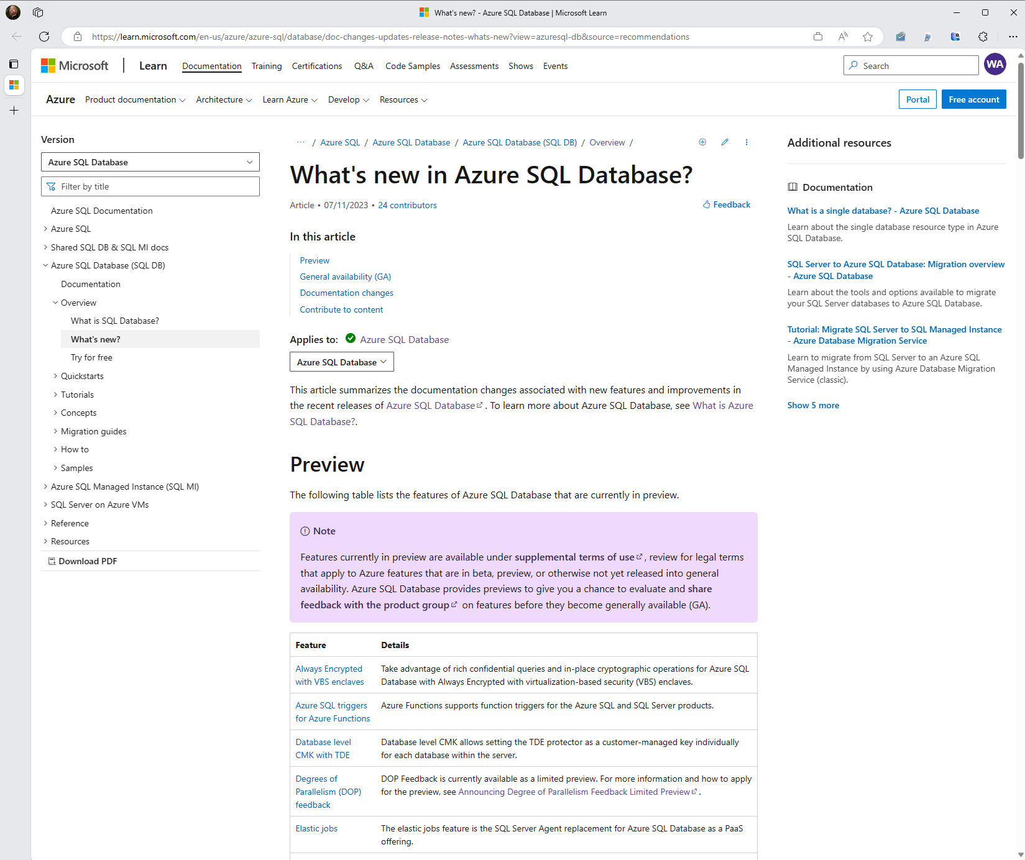
Docs Navigation
Notes:
Just to give you a map around navigating specific docs, and some of the features we have here, without explaining every button.

Slide 10
Doc Navigation Save to Collections
Notes:
This little cluster of buttons is new. The Plus button allows you to Save links to the collections I mentioned earlier, to organize docs into groups that you might be using for a specific project or certification exam. You can save docs to a collection alongside Microsoft Learn modules and Q&A pages as well to gather your materials into one place.

Slide 11
Doc Navigation Save to Collections 2
Notes:
The plus button is alongside the Pencil button and the sharing button.
The Pencil Edit button helps you start a new PR, and that is something we’ll talk about in detail shortly.
Also, the feedback button brings you to the Submit immediate feedback about the article, in the form of a thumbs up/down with some text, what we call verbatim feedback.

Slide 12
Doc Navigation Top Search Bar
Notes:
This is relatively new - these additional resource links are automatically generated by a machine learning algorithm.

Slide 13
Doc Navigation Top Search Bar
Notes:
You see two search boxes on the page. The first, in the top right, searches the entire technology stack you’re in, for example, all of Azure. From that results page, you can expand your search to all of docs.

Slide 14
Doc Navigation Technology TOC
Notes:
Then, the other search box is on top of the table of contents on the left. The TOC includes many different articles for the product, and it is here you can search titles inside a given Table of Contents. You might find that more convenient that a wider scoped search.

Slide 15
Doc Navigation TOC
Notes:
In the center of the first page of the article, you’ll see a mini-table of contents and navigation links to immediately jump to an article’s major headings.

Slide 16
Doc Navigation TOC
Notes:
On many articles, especially SQL reference articles, you’ll find an Applies to: line here, with a hyperlink in each product title. This hyperlink brings you to a Navigation Guide page which has a helpful breakdown of which products are which.
A quick aside, if it says Applies to SQL Server, it probably only means the “box product” or the SQL Server year-based product, or the version of SQL Server you can get in an Azure Virtual Machine, and not Azure SQL Database or Azure SQL Managed Instance. We try to pay a lot of attention to the applies to line and the metadata about which docs apply to which products, if you spot something that doesn’t look right to you, that’s a good question or contribution to bring to us via the methods we’ll talk about later in this presentation.
If there’s any questions by the way about the differences between the big three Azure SQL offerings, I’d be happy to explain.

Slide 17
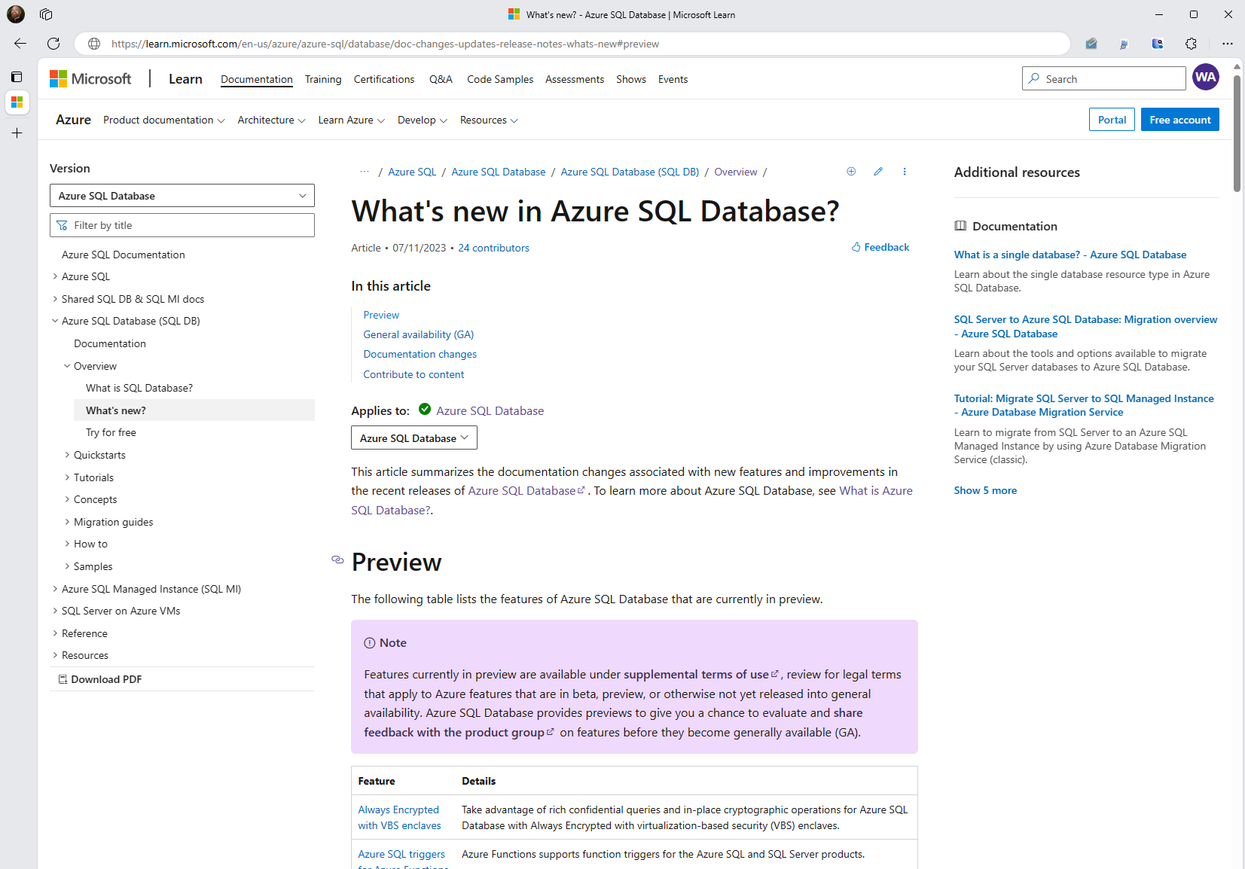
Doc Navigation TOC 2
Notes:
Each header in the article is linkable directly, if you want to send a colleague a link to a heading specifically. You can also hover on a heading, see the link graphic appear, and copy the URL with the page anchor appended.
<click twice to zoom>

Slide 18
Doc Navigation TOC 2

Slide 19
Doc Navigation TOC 2
Notes:
Note that in the top the anchor is appended to the URL.

Slide 20
Doc Navigation PDF
Notes:
Finally in the bottom right hand corner there you see the Download PDF option. You may have seen communication that this feature was going to be disabled in the near future. We heard good feedback from the community about how these PDFs are consumed for offline or remote use, and so we’ve delayed that feature retirement. We do have a new system for offline docs downloads coming soon though, so watch for some new features in that space.

Slide 21
Doc Navigation PDF
Notes:
And hey, why not talk about this article. The What’s New articles in various areas are great inspiration and content for your own social media, blogging, and learning. If you’re a technical blogger or content creator, the What’s new page for various services on Azure is a gold mine of content inspiration, so you can learn and talk about what’s new in the product. For example, perhaps a feature just went from Preview to GA, or general availability, that’d be a great topic.

Slide 22
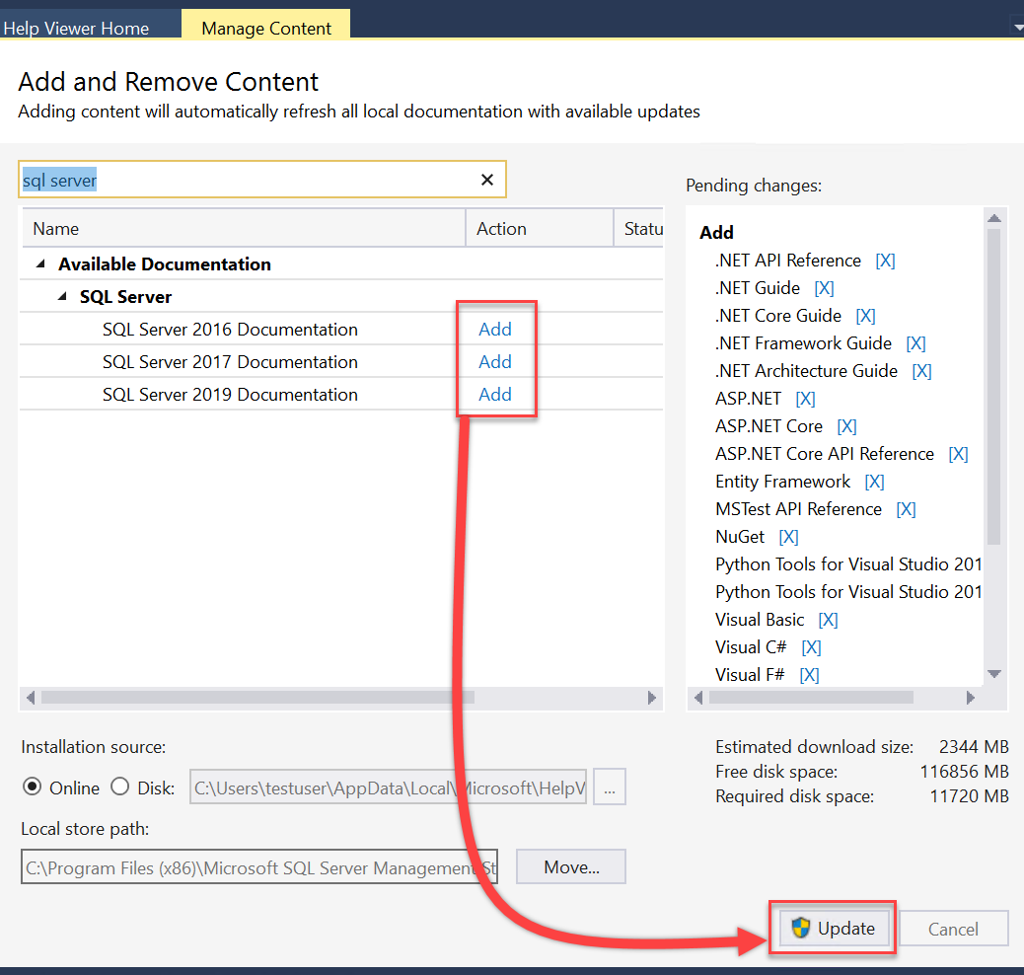
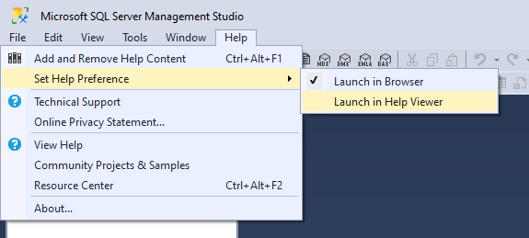
SQL Server offline help
Change Help Preference to “Help Viewer”
Some older content, for example T-SQL reference specific to SQL 2014, is only available Offline. learn.microsoft.com/sql/sql-server/ sql-server-offline-documentation
Notes:
If your work environment is behind an air-gapped or if you work in high-security environments like a nuclear power plant, you can download version-specific docs offline through SSMS.
In fact, some older version-specific content, for example T-SQL reference specific to SQL 2014, is only available Offline.
<Optional>Poll: How many of you work with offline help for SQL?
Our documentation is actually a strategic advantage against competitors. There are very large organizations, including public sector like the Department of Defense, and large private sector companies at the top of the Fortune list, that want their development environments internal and secured from the public internet. In the case of Microsoft’s documentation for SQL Server and Power BI and Azure and all sorts of other products, our documentation is hosted on GitHub, and therefore can easily be cloned periodically and re-hosted internally to those environments, so that those customers can get the best of both worlds – a secure network for development and access to fresh product documentation. Some of our competitors, no joke, want to deliver a few thousand PDF’s or zipped website scraped images or … well, c’mon. learn.microsoft.com actually had a feature to download docs to PDF, but this feature is being retired and will be removed Jan 3 2022. (((If asked it was incompatible with our localization system and had inaccessibility issues with Adobe not rendering Docs properly.))))

Slide 23
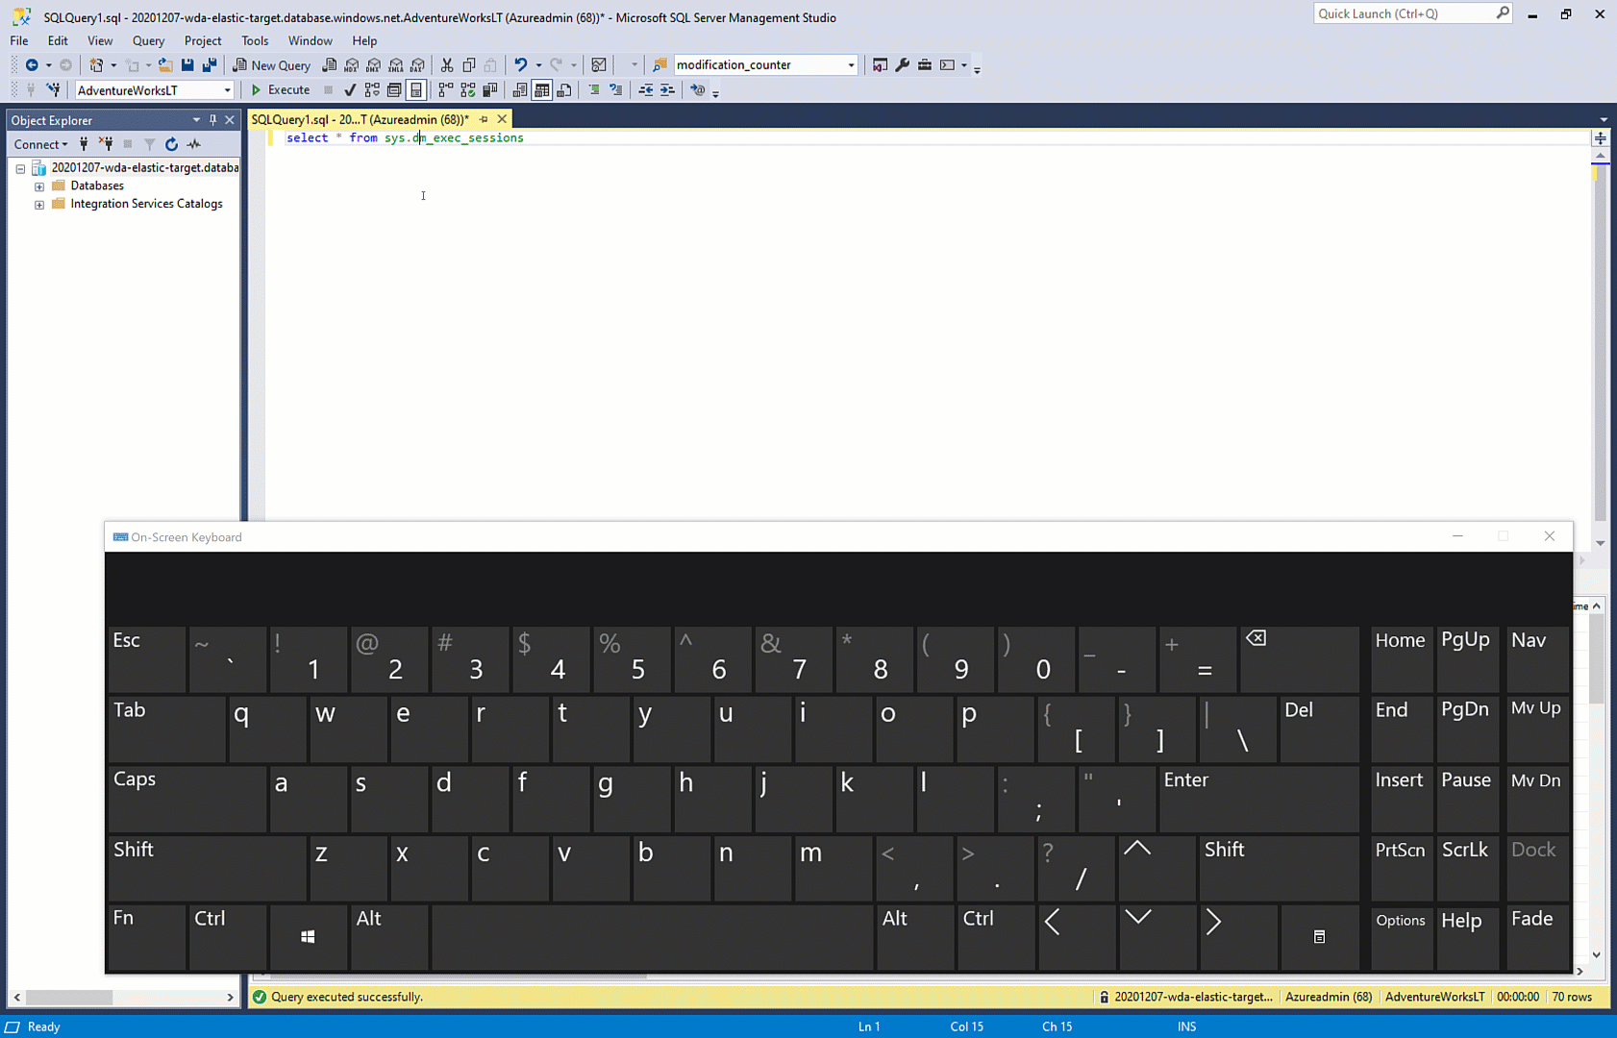
F1
Notes:
[This is a data conference, so] Speaking of Management Studio, not a lot of people are still aware of this, but when you have any text highlighted and you hit F1 in SSMS, SSDT and Visual Studio, the browser should bring you right to the corresponding article for that word of syntax you highlighted, for example.
This assumes your workstation has access to the internet and you have selected the Help Preference of “Open in Browser”, this will bring you directly to the Microsoft Docs Online article, in this case, for the dynamic management view sys.dm_exec_sessions. This works with many many different code keywords.
If you hit F1 on something highlighted and it doesn’t bring you to a specific article, or to a different article than you’d expect, that might be something to fix in Docs via a feedback or a pull request. We’ll talk about that soon.
Are there any questions at this point?

Slide 24
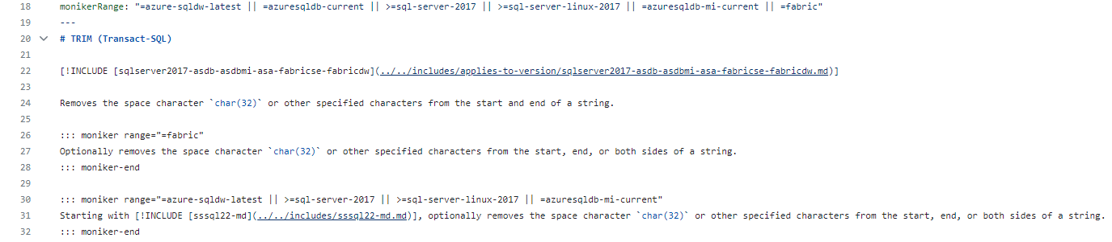
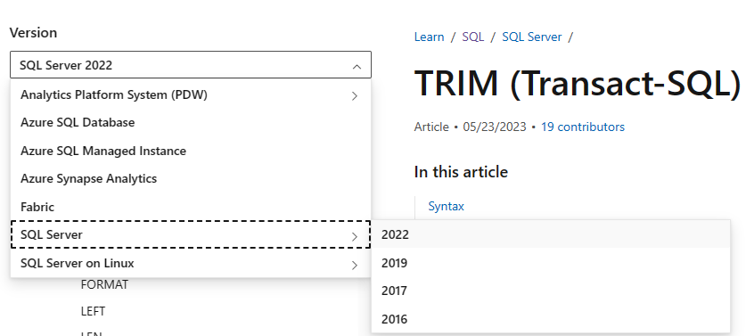






Versioning
Versioning drop-down targets a specific product/service
Changes what you see in an article, TOC
Varies depending on article design
Notes:
Where it makes sense, the same doc might include different information for different versions of the product mentioned.
We may use the same article with various versions of content for Windows vs Linux, or different releases of SQL Server, or different Azure implementations of SQL Server. For example, here’s a code snippet snowing the markdown of the monikerRange metadata and a specific moniker Ranged text in the TRIM syntax article. This on the bottom left is a code snippet of markdown showing how one article might display different content depending on the version requested.
If a doc doesn’t quite look right because of a version specific detail, take a look at the version you’re in. That version drop down list in the top left hand corner of versioned doc areas may come in handy. The version drop down is also affects the Table of Contents by including or excluding certain articles.
Sometimes we’ll handle versioning via tabs inside the document, or clearly state the versions in the Applies To row at the top of the article, or use colorful Note boxes throughout to make sure you know what SQL platform or version of SQL the content covers.
Also note that for content that is specific to older versions of SQL Server before SQL Server 2016, we do still have ways to access that old content, even if some of them are through offline docs only.
And while we support content for all supported versions of SQL Server, just a friendly reminder that SQL 2012 extended support ended in July of 2022, and SQL 2014 extended support ends in July of 2024, about one year away! If you don’t have a migration project plan in place to migrate your SQL 2014 instances, it’s about time!

Slide 25
Contribute to Docs
Notes:
So, how can you contribute to Microsoft Docs? For documentation issues, use the feedback options in Docs if you want but what we really want are GitHub Pull Requests, just as if you were contributing to an open source project.
<OPTIONAL> Poll the audience – how many of you have worked in Git and are familiar with terminology like fork, clone, push, pull, and commit? If you’re not, that’s ok!
Contributing can be done easily through the browser, without having to learn git bash or install anything, without having to know what a fork, clone, push, or pull is. We’ll have an explanation later on how that process works if you’re unfamiliar.
If you already work with Git or GitHub and are familiar with pull requests and remote repositories, you can do that, and later we’ll talk about how this process works behind the scenes.
But in the case of SQL Docs, a lot of DBA’s aren’t familiar with Git, and that’s not a problem! Anyone can help, easily, using the browser only.

Slide 26
Anyone can contribute to Microsoft Docs!
learn.microsoft.com/contribute/
Help edit docs for the entire community
Contributors listed on top of each article
We average ~150M pageviews/month
You need a free GitHub.com account
Contribute to Docs entirely in browser
Let’s walk through it
Notes:
We even have a step by step tutorial at this URL here to guide you through the process of creating a PR.
<click>
By contributing to Microsoft Docs, for any product technology, you can be a part of the community and help edit docs that everyone uses.
<click>
We’ll talk about the contributor designation on top of the article,
<click>
where we average around 128 million page views/month across all of Docs, 11 million in SQL docs alone.
<click>
if you want, You can do this entirely in the browser using GitHub dot com, with nothing to download or install.
<click>
All you need is a free GitHub.com account
<click>
Let’s walk through it…

Slide 27
GitHub Authentication
Enable 2-factor auth (TFA) for GitHub
https://github.com/settings/security
Backup your TFA backup codes!
Notes:
You really should enable two-factor authentication (2FA) on your GitHub account, this is required for more corporate repositories including for Microsoft Employees to contribute to Microsoft private/internal repositories. I recommend NOT using ONLY your phone number or phone app for this. Recently had a Microsoft engineer lose his phone, get a new one, and find himself unable to access his GitHub account. Definitely recommend not just using your phone number, as SIM swpa attacks those are a common vector for bypassing MFA. A hardware key with backup copies or some other method besides that expensive commodity in your pocket is probably a better choice.
<click>
Regardless of the method of multifactor authentication, be sure also to download & save your 2FA recovery codes if you didn't already. Take two-factor authentication seriously! Do NOT lose these recovery codes! If you lose your device and don’t have the recovery codes you will lose access to your account and it cannot be recovered. This could have, for example, saved the Microsoft engineer I mentioned before who lost his phone. You can access your backup recovery codes in your GitHub account settings, under Account Security.

Slide 28
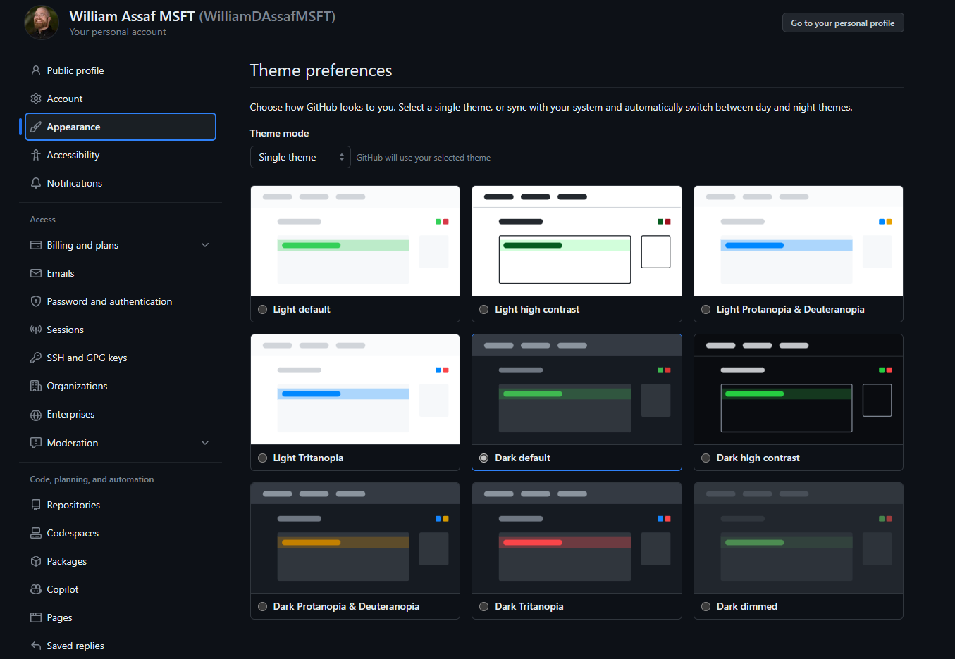
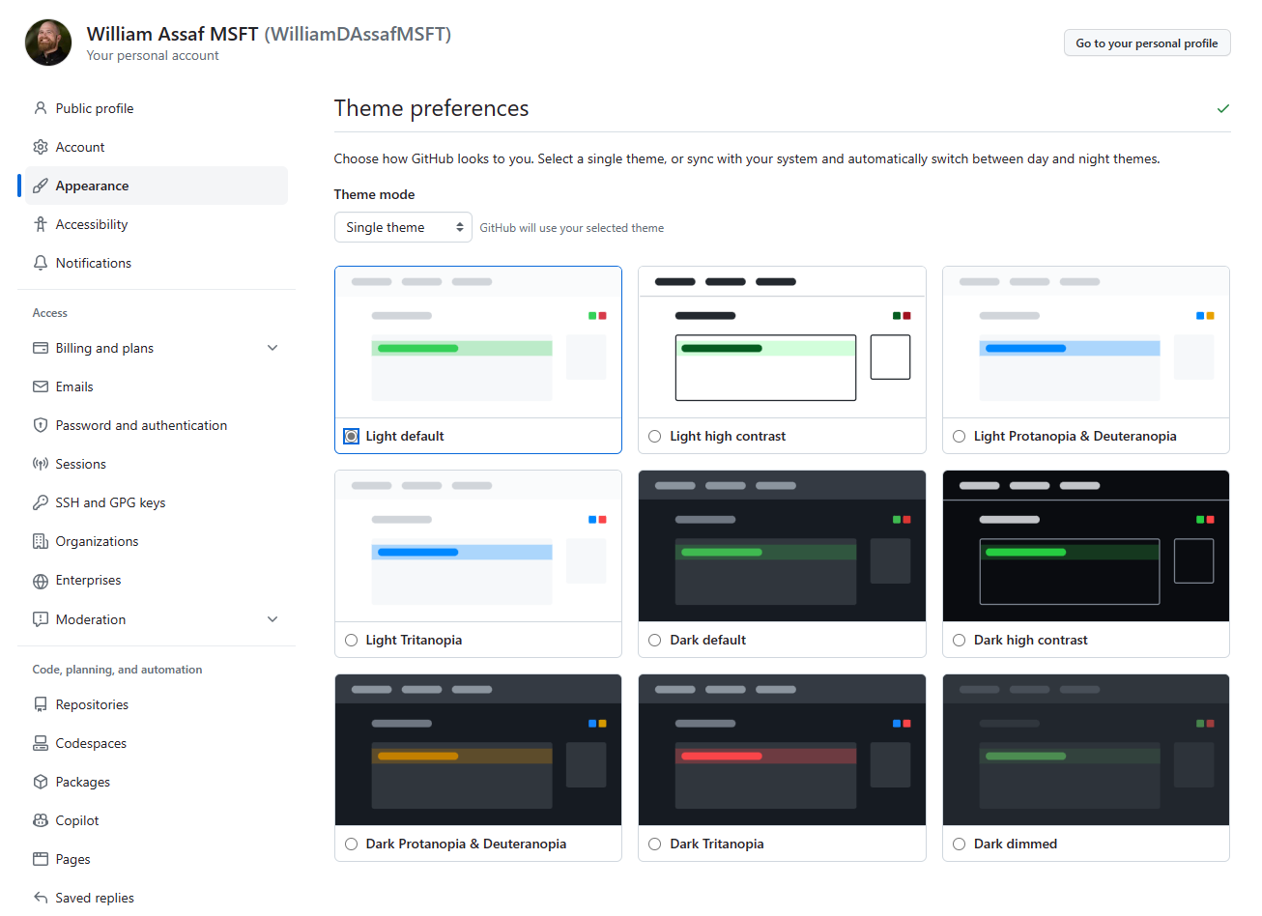
GitHub Dark Theme
Dark Theme in GitHub
Notes:
While we’re at it, did you know there’s a GitHub dark mode now?
A couple ways to change your theme in GitHub, in your account’s settings then the Appearance menu, including having it automatically sync to your Chrome and Windows appearance settings for night/day.

Slide 29
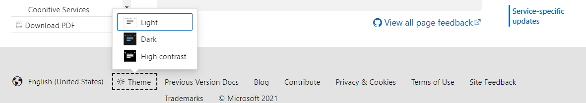
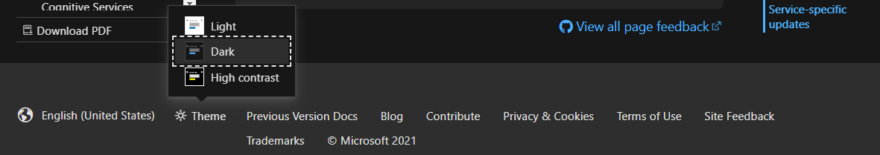
Dark Theme in learn.microsoft.com too
Notes:
Also, if you’re an enthusiast for dark mode websites, learn.microsoft.com has a dark theme too! Check out the footer of any docs website to change your theme.
Also, Dark Mode has arrived in the latest Microsoft Word and I hear is coming soon to LinkedIn!

Slide 30
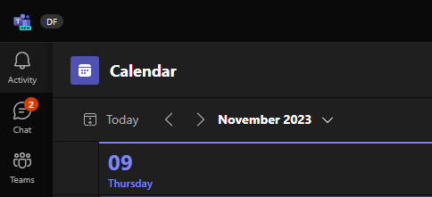
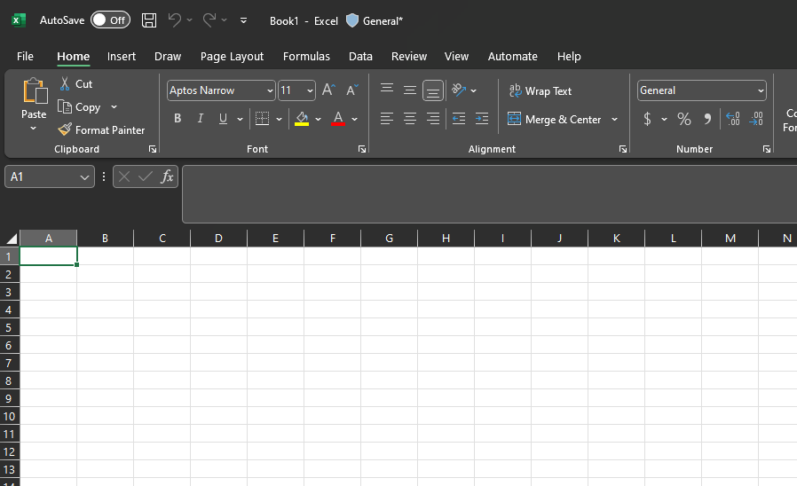
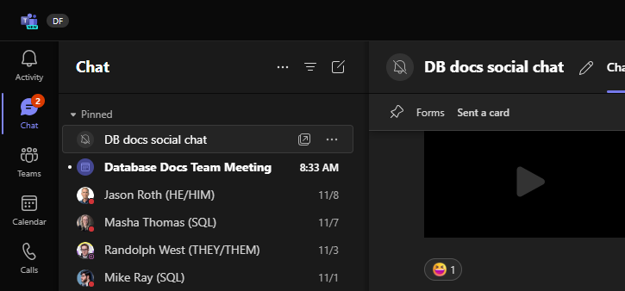
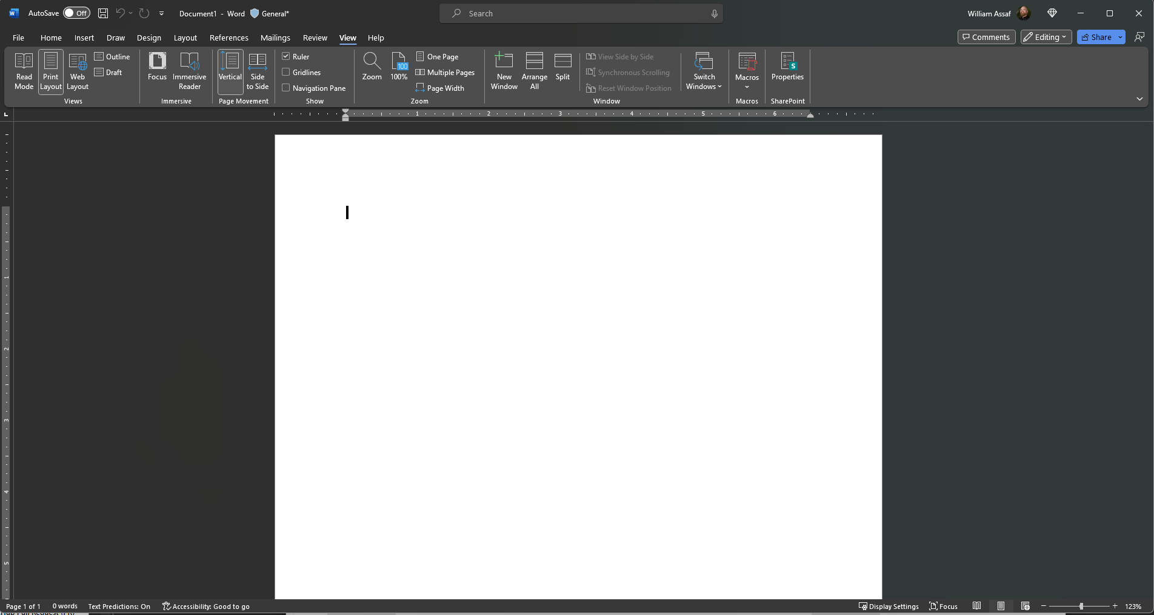
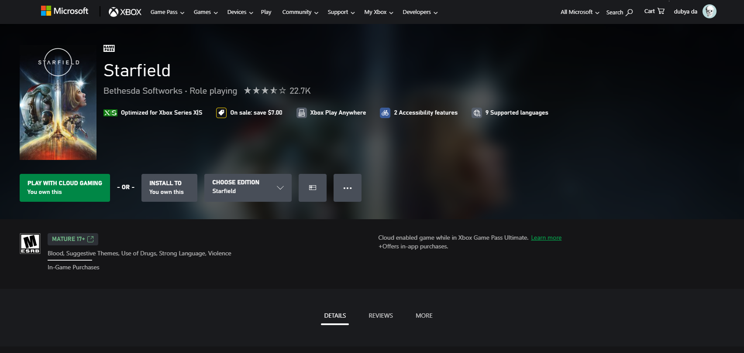
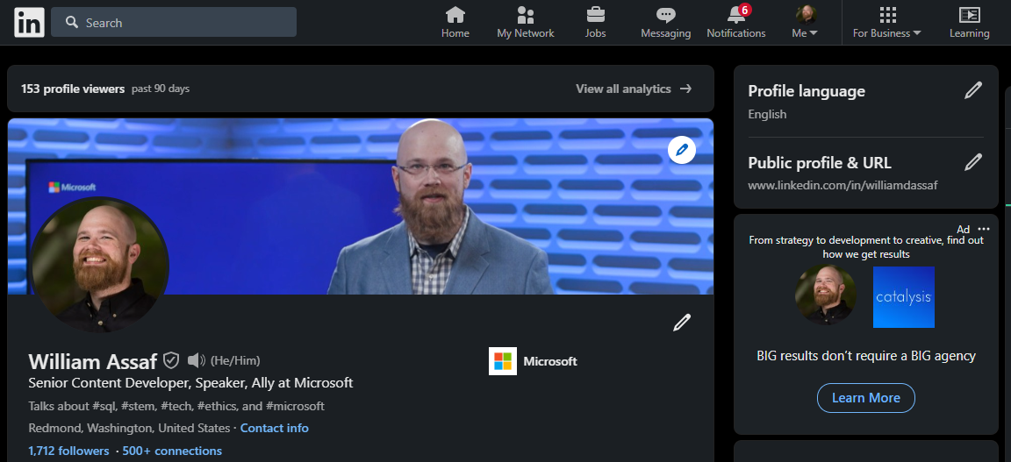
Dark Theme in LinkedIn, Teams, Office
Notes:
Dark mode has also arrived in LinkedIn, Teams, all the Office apps, and even XBOX Gamepass pages are dark mode by default! Hooray!

Slide 31

What belongs in Docs issues and PRs?
For support issues, contact Support or partner.
For product ideas and product feedback, use feedback.azure.com
For SQL: easy to remember URL: aka.ms/SQLfeedback
Docs feedback address the docs – not a product problem or request.
To submit an issue, this has evolved recently. We’d much rather receive PRs.
Notes:
To be clear, support issues don’t belong in document feedback. The feedback options we’re about to discuss are not Microsoft Support and has no SLA for response time. If you’re having a problem or unexpected behavior or an outage or need help troubleshooting an error, contact Microsoft Support or your support partner. The doc about the feature is not the place to start, as accessible as it may be. We triage incoming issues and PR’s from GitHub and if it sounds like a support issue, your issue will likely be closed up with a polite message and some links.
<click>
For Product Ideas and product feedback, we have a relatively new site for this. You might remember the Connect items or UserVoice systems of the past, that has been replaced by a new system hosted at feedback.azure.com. And most of the old ideas have been migrated, though for GDPR and privacy purposes, comments from external users have been removed from this site when the product ideas were migrated. Feedback.azure.com hosts product feedback channels for many Microsoft products and technologies, not just SQL Server. For SQL feedback though, there’s an even easier to remember URL for the SQL Server feedback list: aka.ms/SQLfeedback
<click>
Most Docs issues that get attention are a request to fix something missing or outdated or wrong, or, a request to add something that would have helped prevent an error, outage, etc.

Slide 32
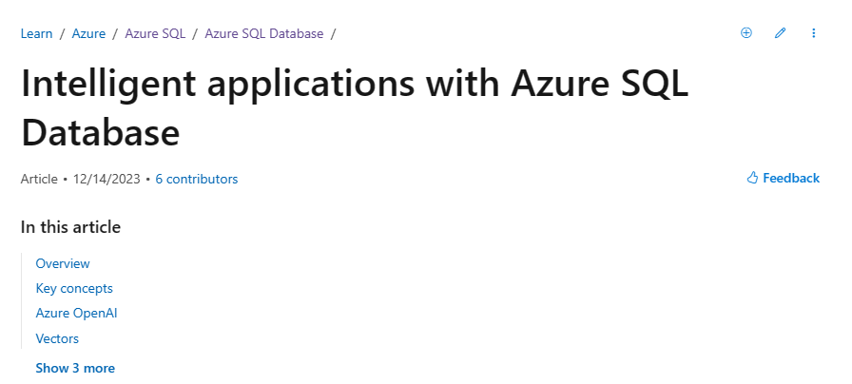

Contribute via a GitHub Pull Request (PR)
Notes:
OK, back to contributing.
Second option, you’ve found something in documentation that’s out of date or wrong or missing, and you want to suggest the edits yourself; you can click on the “Pencil” button in the top right-hand corner. <click for screenshot>

Slide 33
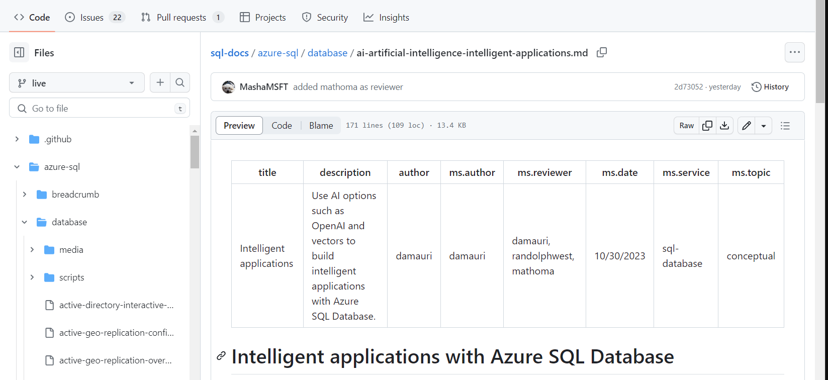
GitHub Edit Article Pencil
Notes:
Clicking the Pencil button on top of a doc brings you to the GitHub preview page for that article. From here, click the Pencil button on the top right header bar, boxed in red. You want to start an edit in place.

Slide 34
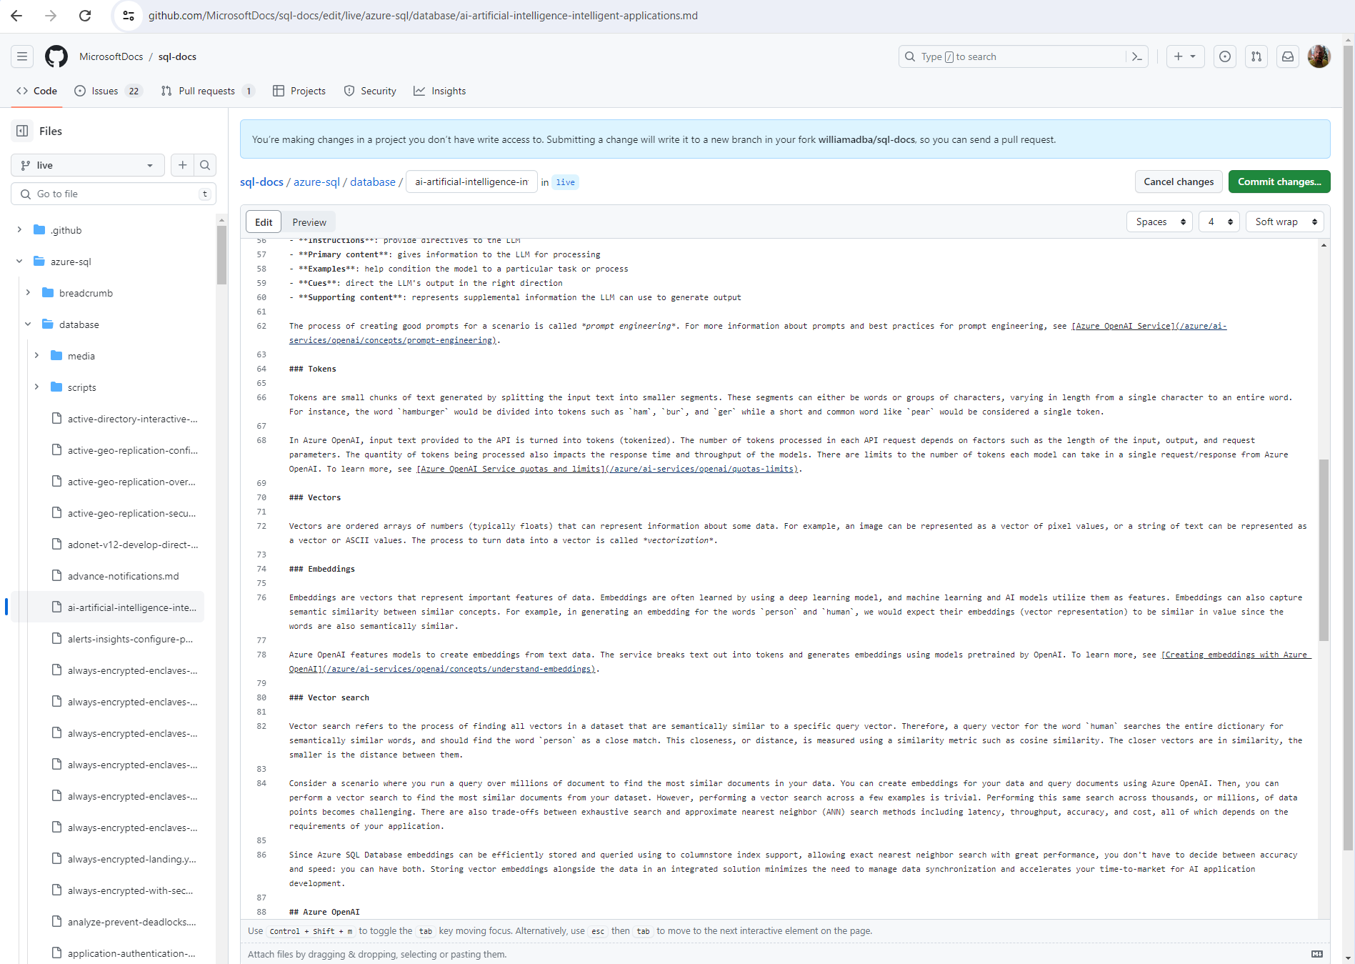
Edit article in GitHub
Notes:
After you click the second Pencil button, now you’re looking at the actual markdown code in a text edit box.
It might surprise you to learn that Microsoft Docs are not edited Microsoft Word documents, but rather in code, in markdown or yaml. Markdown is a lightweight text markup language created for formatting rich text with a plain text editor. GitHub has their own formal implementation of markdown called GitHub Flavored Markdown. Many different online sites use markdown for their content, including GitHub, GitLab, Reddit, Stack Exchange, BitBucket, Drupal, and more. So you might be more familiar with markdown than you think already.
Make your changes here in the text box! If you’re not familiar with markdown, it’s pretty easy to understand once you get rolling, and don’t worry about it being perfect. The Content Team will always review your content submission and potentially tweak it to Microsoft standards before it is merged live. There are plenty of resources online for basic markdown syntax, but if you don’t get something quite right, don’t sweat it.

Slide 35
GitHub Edit article Commit changes… button
Notes:
Once you’ve made your changes, hit the big Green “Commit changes…” button. Here you can propose changes by committing your changes to your own branch.

Slide 36
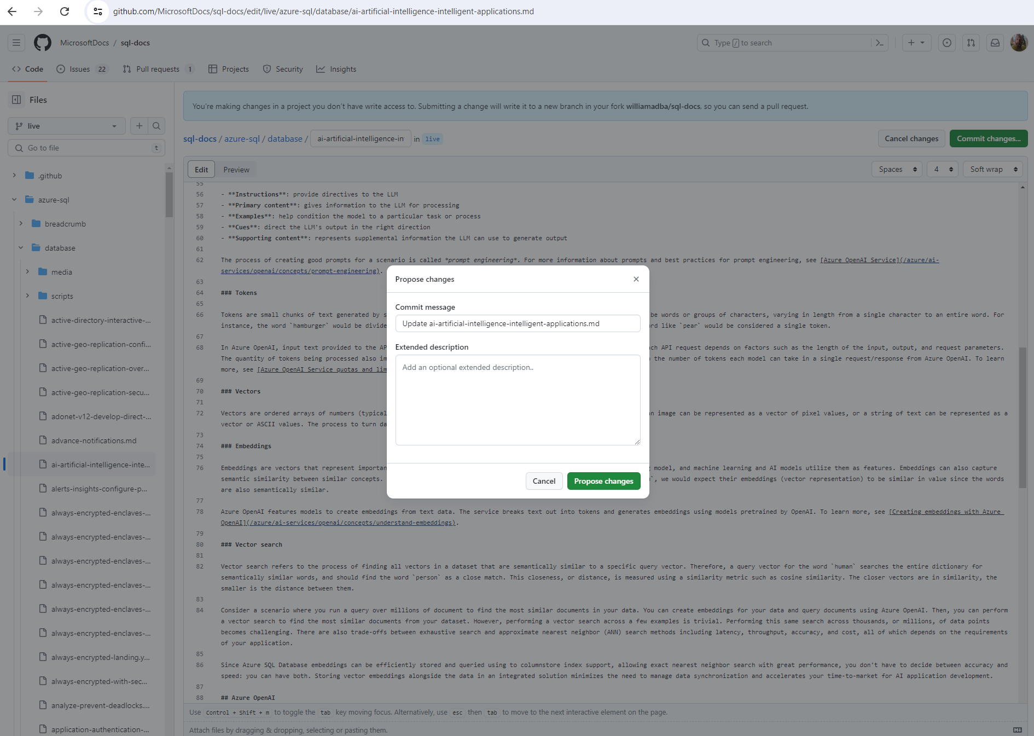
GitHub Edit article Commit changes… button
Notes:
In the popup window, enter your PR title and comments. The default commit message is fine, but it will be public, so maybe make it informative.
If you’re not familiar with GitHub terminology like pull requests, don’t worry, you don’t have to be! Once you click the green “Propose changes” button, we’ll take it from here and keep you updated as your new Pull Request moves through the process.
Your changes to the markdown of the file will be proposed for merge, triaged, and reviewed by the article author and reviewers. The content team for the article takes it from there, replies in the PR comments, makes further edits if necessary, and eventually decide whether or not to merge your changes. You’ll be notified along the way with feedback directly from one of us on the content team.
Again, you can do all this if you want through your own tooling, to create your own fork, branch, commits, push and Pull Request… That’s what we on the Content Teams do every day. But if you want to just use the GitHub.com website to handle the entire process for you, it’s much easier!

Slide 37
Your new Pull Request
The PR will be assigned to human reviewers.
Human and automated messages from the build engine will appear in the Conversation tab.
Select the Files changed tab to review line by line.
Others can make comments or suggestions.

Slide 38
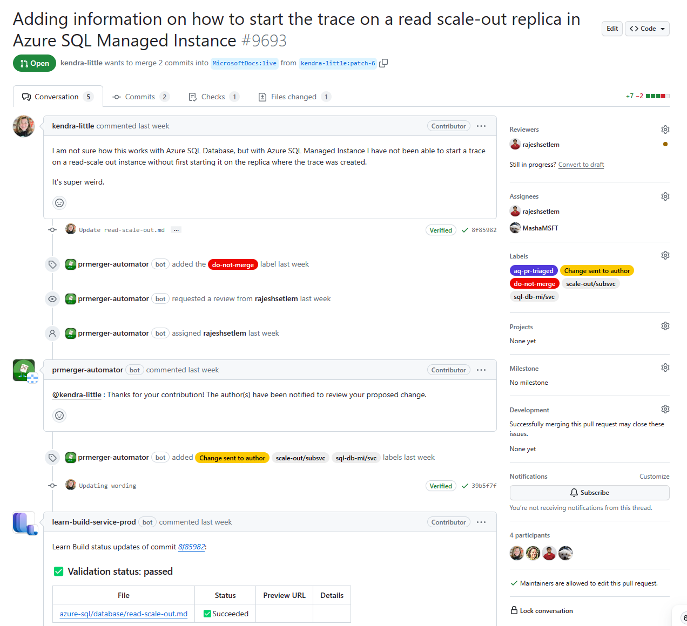
Pull Request Created
Notes:
Here’s what it looks like after you’ve submitted your pull request.
First, automated systems kick in, adding metadata and tags and automatically assigning some Microsoft staff.
Human authors and reviewers will be assigned, and both human and automated messages will appear in this Conversation tab.
You can see the Blue arrow pointing here to the commit in the branch.

Slide 39
Pull Request Created
Notes:
Have another edit to make? That’s easy. You can see with the two blue arrows here, Kendra has added two commits to this branch. Two commits show up in the Conversation tab.
A branch can include one or many commits for one or many files.
A pull request is simply a relationship between two branches.
How do you go about adding another commit?

Slide 40
Pull Request Created
Notes:
If you want, open up your branch again, just click on the link to the branch in your fork, that’s the red box right there, and you can add more edits to this or other files.

Slide 41
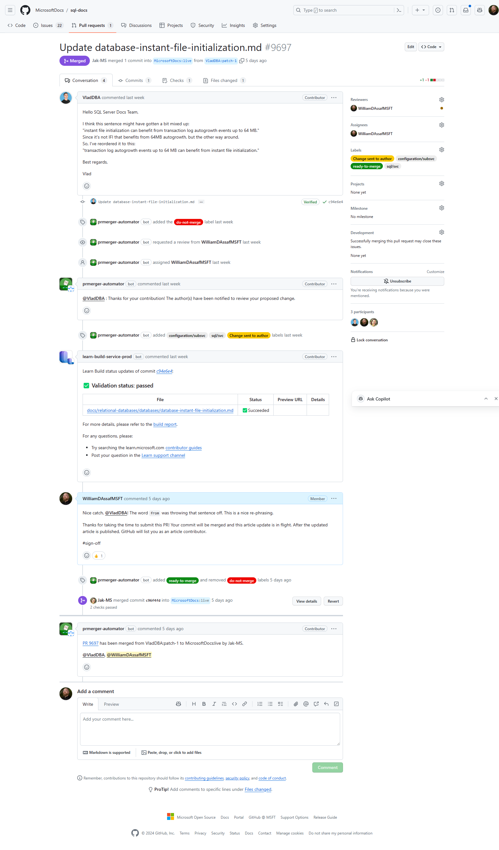
Pull Request Created 1
Notes:
Your PR will start in an Open status, let’s look at one that is Merged, which means it’s been accepted and soon will be merged to the live production repo, usually within a day.
This was an excellent PR worth showing off.
You can see what GitHub did for you was to automatically in the background create a fork, create a branch here in the user’s name, called patch-1.
<click>
The pull request includes the commit, which is in the PR log right here with the red arrow.

Slide 42
Pull Request Created 2
Notes:
The PR log contains both automated and manually created messages, automation for the merge engines, all commits, and conversation and notes from anyone assigned. Eventually, someone on the content team like myself will review and maybe make some edits and maybe sign off on the change and have it merged, and you’ll see those comments too. You’ll receive an email anytime anyone uses your username with an @ symbol, and you can respond in conversation at the bottom here with the comment button.

Slide 43
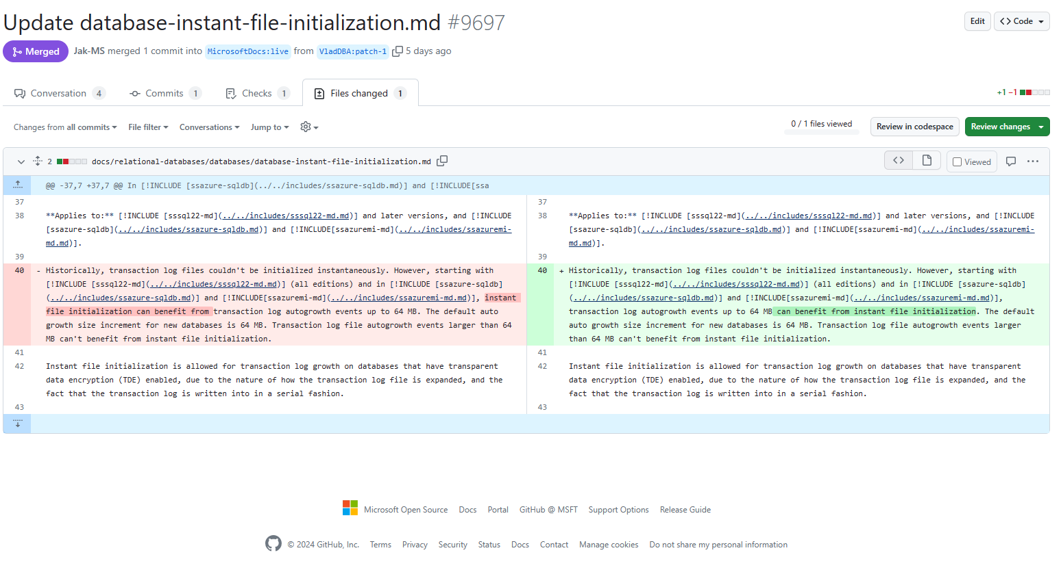
Pull Request Created 3
Notes:
Once your Pull Request is created, both you and Microsoft can review the changes you’re suggesting in the Pull Request.
This is the “Files Changed” tab, which shows an in-browser differential. Red is the old code line, green is the new, and the changed characters are highlighted.

Slide 44
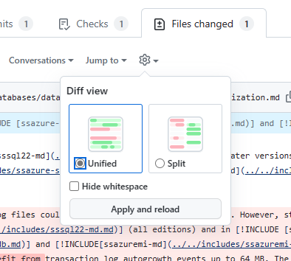
Pull Request Created 3
Notes:
If you don’t like the side-by-side comparison, you can do a unified view where the changed lines are stacked.

Slide 45
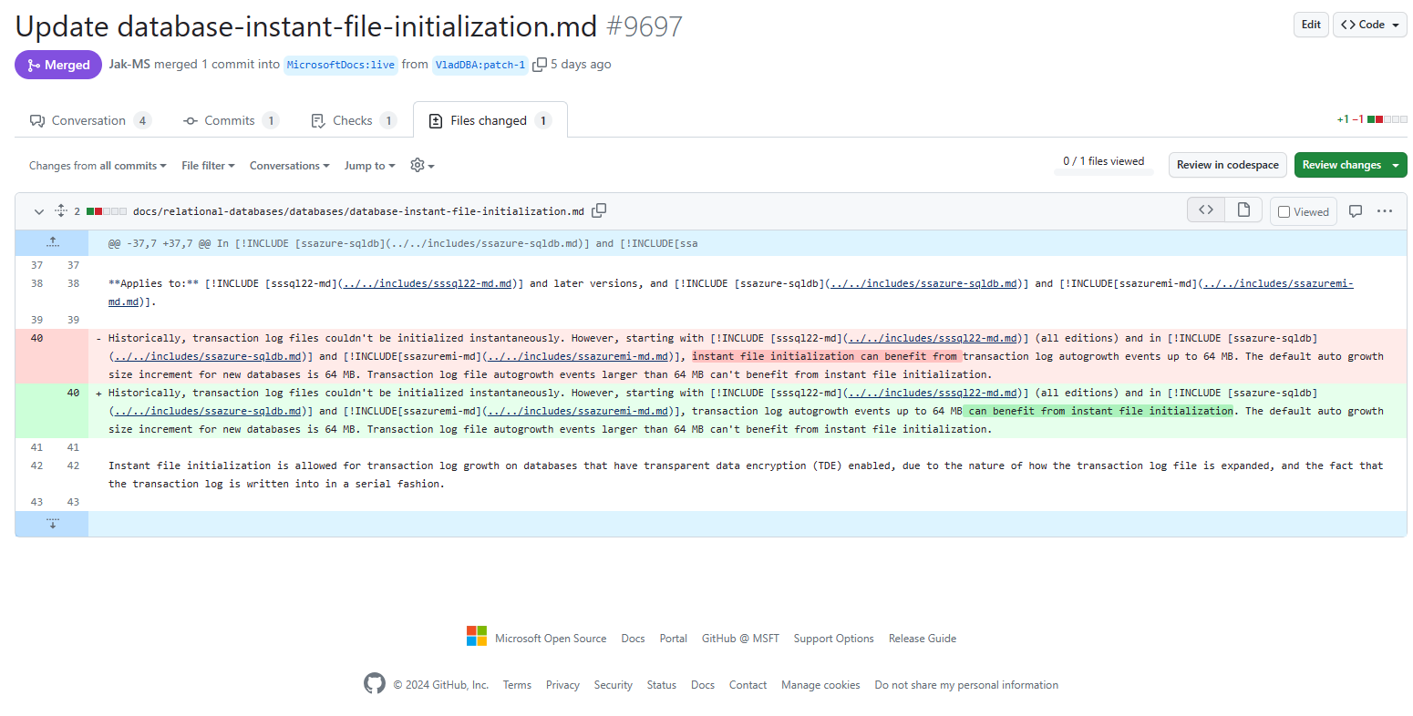
Pull Request Created 3
Notes:
Here we can see some updates to make a sentence clearer, perhaps a sentence that didn’t translate well or was unclear or vague, and this is a good edit.
If you’re trying to describe how something should change, simply making the change yourself is usually much easier … than trying to describe your contribution clearly.
<click>
Again, if you want to make more changes to the file, you can create another commit to the pull request. Here’s another way. Simply click on the three dots icon here and click Edit file. Edit the same file, hit the big green button to submit another commit to the same branch, and it will be included in the same open pull request.
But there’s an even more interactive, collaborative way to contribute to Pull Requests in GitHub.

Slide 46
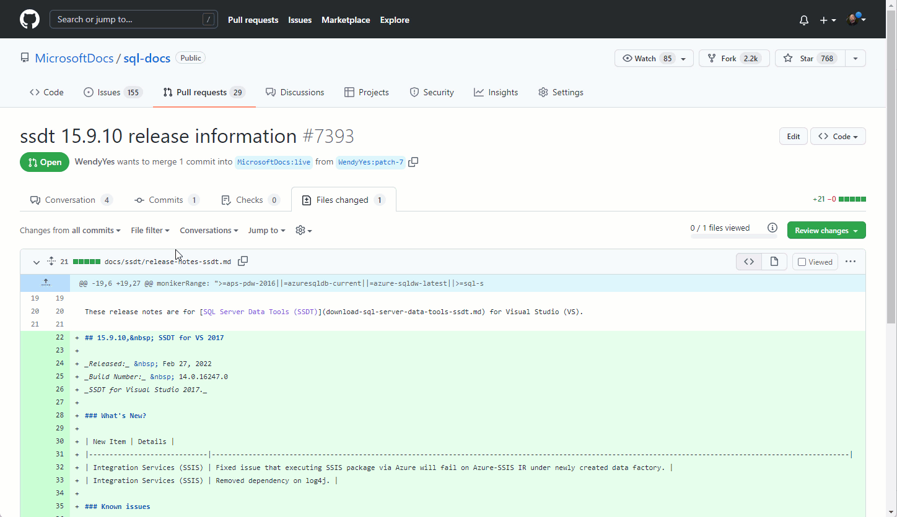
Edit PR in-line
Notes:
I want to show this off because GitHub introduced this only in the past year or two, and these the in-browser suggestions are a really easy way to collaborate on a PR. We do this internally between docs, product, and engineering teams at Microsoft regularly.
Minor edits can, like we talked about before, be suggested entirely within the browser. In an existing Pull Request, you can comment and suggest changes all in the browser!
Or, instead of editing the whole file, you or anyone else, and I’ll repeat that, anyone else can join your effort to update the doc by contributing a suggestion. Here’s a gif walking through the example
I want to show this off because GitHub introduced this only in the past year or two, and these the in-browser suggestions are a really easy way to collaborate on a PR. We do this internally between docs, product, and engineering teams at Microsoft regularly.
Minor edits can be suggested entirely within the browser. In an existing Pull Request, you can comment and suggest changes all in the browser! You might see us make suggestions or changes to your Pull request this way.
In the Files Changed tab of a PR, where you’re reviewing the line by line changes, select the blue plus button on any line number of changed code. Then select the “Add a suggestion” button that looks like a plus-minus box.
Now you’re editing the line or lines you’ve selected with the blue plus button. You can then submit this change to the actual author as a single comment, or, you can click the green “Start a review” button to make many different suggestions and comments, and submit them all at once.

Slide 47
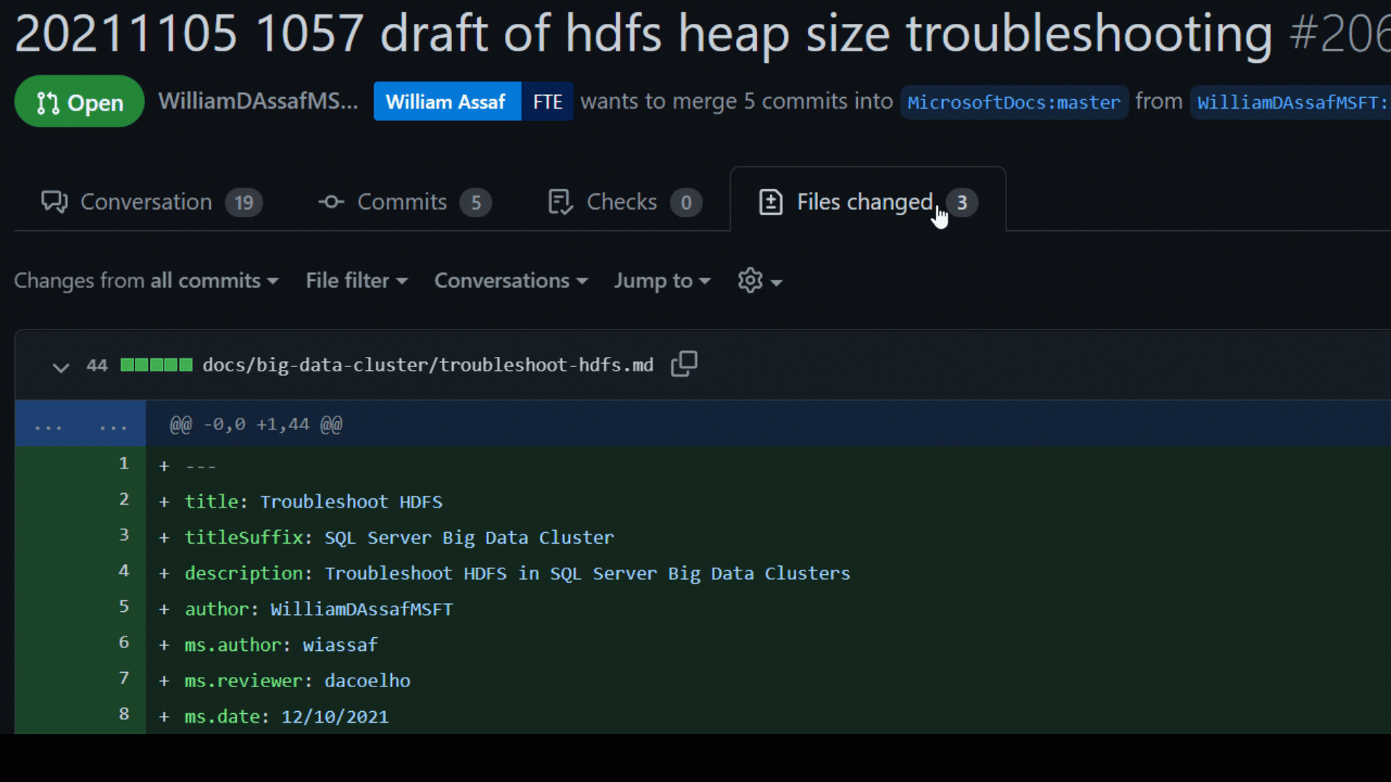
In-browser collaboration in Files Changed tab
Notes:
Here’s another view of the blue plus button in action, this time editing multiple lines.
All this makes it easy to collaborate with doc authors and reviewers entirely within GitHub.com.
After you’ve submitted your PR and you’re happy with the changes, and you can sit back, we got it from here and will let you know if we have more questions, or have a status update.

Slide 48
Publishing
Eventually, MSFT comments #sign-off
A non-technical v- editor may review.
Published 2x a day, around 10amPT and 3pmPT
Notes:
Eventually, someone, usually the content developer or the author of the article, writes “#sign-off” in the Pull Request comments. The #sign-off comment starts a process behind the scenes. More information will show up in the PR log. If it’s small enough and qualifies based on a few different criteria, it might just quickly and automatically merge into the branch…
<click>
But, commonly, depending on the amount of change and some other factors, a human editor will review and merge the pull request. This is someone non-technical who will review for compliance and style.
<click>
Once merged, the doc will be published live on the Learn.Microsoft.com website twice a day, usually around 10AM or 3PM pacific time, though the exact timing varies. Some repos have a third publishing window overnight around 4AM Pacific.

Slide 49
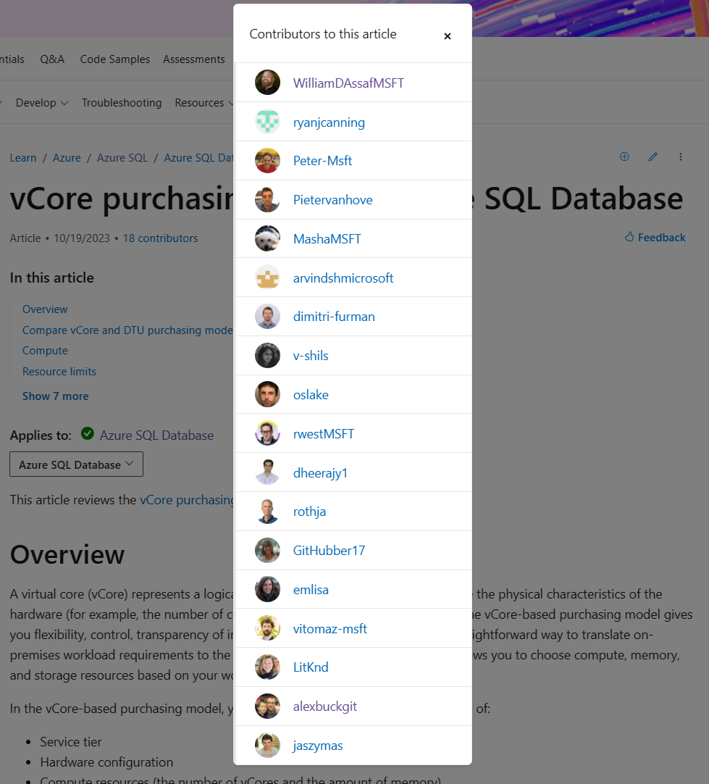
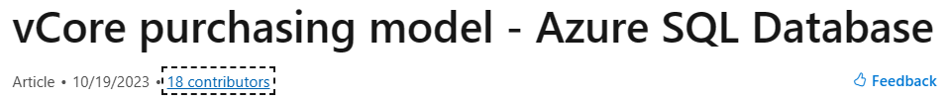

Credit Due!
Notes:
If you contributed via a Pull Request, and we merge your commit into the document, you’ll get mentioned in the contributors popup, with your GitHub profile pic and a link! The folks listed here are both inside Microsoft and external that submitted commits to an article.
Worth mentioning that if you start a PR, even if we close it and pull in your commits with a different PR, you would still be recognized here.
Also these contributions can be a part of your MVP application or renewal activity, though a fair warning that yes, these contributions are examined for quality as well as quantity, so they won’t weigh as heavily contributions to punctuation or capitalization as they would contributions to actual technical content.

Slide 50
Tips on contribution
Notes:
We want you to contribute

Slide 51

Stop worrying and love the Pull Request
If you're not sure how it should change, just give it a shot.
Image or graphic needs to be updated? We got it.
cApItAlIzAtIoN iS tOuGh. We get it.
“Azure SQL Database” vs “a database”
“Azure Functions” vs “a function”
When you go to Taco Time, you eat a taco, not a Taco.
Informative comments in code must also appear in text.
Code is not translated. Break up large code blocks and explain.
Helpful comments must be explained outside of code, too.
Above all, be simple and human.
Notes:
If you're not sure how it should change, give it a shot. If it’s not quite right, or formatted perfectly, don’t worry! We’ll adjust, but at least it gets fixed! Don’t be afraid to submit a pull request. Here’s some other notes to ease your anxiety and put you at ease.
<click>
For images, graphics, charts, etc., we have designers to use to get images updated in a standardized way. No need to edit images yourself, though you could make suggestions to image updates along with alt text changes within the markdown, for example, via a Pull Request.
<click>
Finally, we get it, capitalization is tough, (spongebob font). The capitalization of various features and products inside Microsoft is one of the most nuanced bits there is about publishing. Marketing usually wins these arguments, regardless of how a product documentation evolved throughout its development process.
We sometimes get big PRs that come thru to make a lot of capitalization changes that were well intended, but misguided. The task is tricky enough when you have information directly from the inside sources, so we’ll handle that part of the docs.
Yes, if you spot inconsistencies between marketing content and documentation content and training content, we’re regularly discussing and working on that stuff internally, and don’t be afraid to point something out.
For example, product names and feature names are trickiest when a generic word is in the product name. Just because we have a product called Azure SQL Database, doesn’t meant that every word Database is now capitalized. Or the product Azure Functions, versus, a function. Try to remember that when you go to Taco Time, you order a taco, not a Taco.
This is even more difficult for our international partners and customers, because capitalization often means a product or service name shouldn't be translated or should be translated in a specific way, but the lower case common noun of the same term should be translated. Translation is difficult enough, so it’s important we get this right, and inconsistency in capitalization confuses translators and customers.
<click>
When it comes to comments in code, those are great, but code isn’t translated into dozens of languages. So Docs must to explain code outside of the code snippet. If you see code that isn’t properly explains outside the code snippet, that’s a good pull request!
<click>
When it comes to grammar, and style, and capitalization, and code comments and everything else we’ve talked about, remember the core goals of our brand voice: Above all, be simple and human. Don’t be too informal, but use common word choices, stay away from jargon or extremely technical terms, even if they are technically accurate. Let’s make sure we’re writing docs that are helpful and approachable.
If we can do better to meet that goal, let us know!

Slide 52

Localization/Translation Feedback
Translation issues are submitted via a Microsoft 365 Form
aka.ms/provide-feedback
Submit feedback in any language.
Automatically creates Azure DevOps work item.
Non-English technical feedback? No problem.
Same link: aka.ms/provide-feedback
It will be translated and passed along internally.
Notes:
One last bit about contributions for localization issues, such as a translation issue in our localized versions.
If you’ve got a translation issue to raise, those are submitted by Microsoft 365 Form. Submit your feedback in any language to this form, it will be translated and routed to the correct localization team. Per the localization team, the feedback will be triaged within 24 hours during working days, and if valid, fixed within 1-2 weeks.
If you’ve got a technical issue with an article, and you’re most comfortable submitting your issue in another language, no problem. Instead of creating a Pull Request in English, you can use that same form, it will be translated, and then passed on to the proper content teams, like our SQL Docs team.
Either way, thanks for contributing to making Microsoft Docs better for everyone, everywhere.

Slide 53
How GitHub Hosts Microsoft Docs
Notes:
So, now that you’ve seen how you can use GitHub to contribute to Docs, let’s briefly show you some inside baseball and talk about how we use GitHub to host Microsoft Documentation.

Slide 54

Docs Behind the Scenes
VS Code or Azure Data Studio, gitbash, GitHub
Rich metadata and SEO tracking, Kusto
Release branches for big, timed doc releases
Notes:
Again, most Microsoft Docs are edited in Markdown. We spend most of our time using Visual Studio Code or Azure Data Studio to edit them. We have other tools to help with automated link checking, syntax formatting, bulk updates, and a series of include files to tokenize things like product names.
<click>
We have a rich set of metadata for each article. We do pay attention to how articles perform in terms of Search Engine Optimization and traffic patterns and trends, all driven through Azure Analytics and Kusto queries. We try to improve poorly performing articles. We use many metrics to track the performance of an article including, for example, if you copy text from the article, that’s good! Or if you click through, scroll, dwell, the same kind of metrics that any website uses these days to measure how effective the web page is, without capturing any personal information or wider tracking information. Most of our decisions with docs and docs layouts are data driven, when we we’ve driven better engagement and more useful docs, we try to follow that lead.
<click>
For big article updates we have systems to handle release branches – for when we want to work on documentation for months and then release a new product all at once, like during an Ignite keynote. Many of these strategies aren’t far off from what developers use to release software all at once, and use the same tools. Happy to answer any questions about that, but moving on to some basics of GitHub…

Slide 55
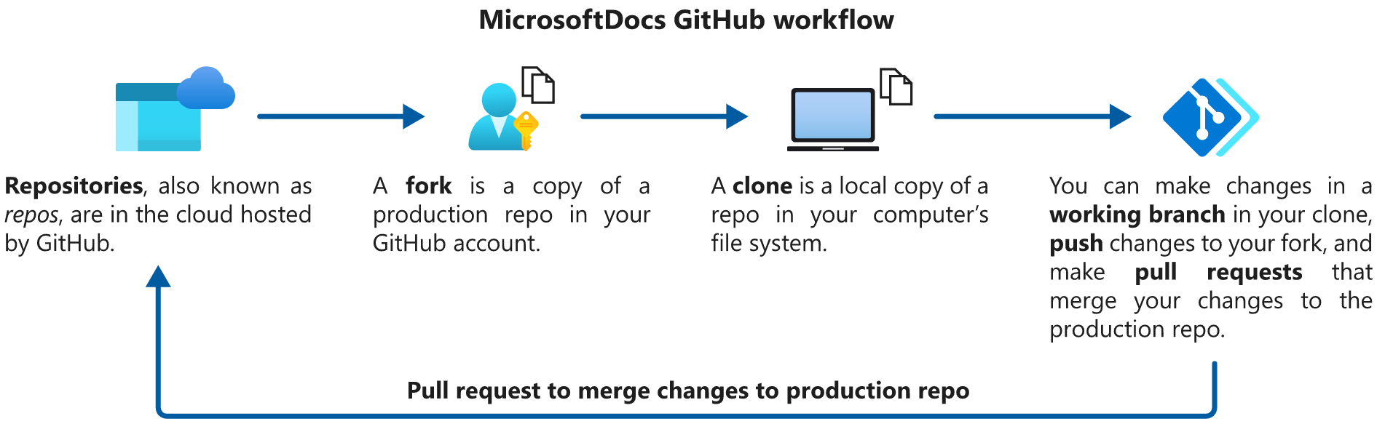
GitHub Basics
Notes:
This is behind the scenes of how Microsoft Docs works in GitHub, where all Microsoft Documentation is managed. If you are new to Git and don’t understand this don’t worry, as we’ll explain, to contributors in the community, all this is managed for you.
Here’s the basic GitHub Workflow.

Slide 56
GitHub Basics 2
Upstream Origin
Local
MicrosoftDocs/ azure-docs
username/ azure-docs
username/ azure-docs
username/ azure-docs.
20230215-fix-issue
Pull Request
Push
Commit
Notes:
A repository, like azure-docs, is where the source is housed and where the website engine pulls markdown to present the live pictures to you in websites.
<click>
A fork is a copy of the repo associated to your account up in GitHub. We each have created forks of the repo in our GitHub accounts. This is created for you in GitHub with a single click of a big green button the first time you need it.
<click>
To tell the two apart, a common convention is to reference your remote fork as Origin, and the codebase you eventually push to called Upstream. These are called Remote names or Remotes, and these are just common naming conventions, you can choose any name. You’ll have an origin and an upstream for each repo you work in.
<click>
A clone is a copy of a fork brought down locally, the files copied on to your workstation, so you can make edits.
<click>
When you go to make changes to a file, or to add or remove files, you’ll create a working branch that is relevant to the chunk of changes you’ll be making. You want a branch to contain only the changes for a specific feature or issue you’re addressing, so that it can be treated as a block of changes to go back up the stream.
<click>
Your work goes into a branch, here the branch is "fix-issue" with the iso date appended to the front. When you’re done, first, you commit the branch locally to your own clone on your workstation.
<click>
Then, you push a branch, and all the commits for it, to your Origin in GitHub.com, the fork of the code in your GitHub account.
<click>
Then, you create a Pull Request. A pull request is a comparison between two branches. Here, you ask a MicrosoftDocs repository branch to accept commits from your repository’s branch, so that your changes can be merged from your Fork into the repo’s main branch.

Slide 57
GitHub Basics 3
Live Upstream Origin Local
MicrosoftDocs/ azure-docs
MicrosoftDocs/ azure-docs-pr
username/ azure-docs-pr
username/ azure-docs-pr
username/ azure-docs-pr.
20230215-fix-issue
Automated Build
Notes:
To explain things a little closer to the reality of how we work internally, we actually have two repositories in the MicrosoftDocs account.
The azure-docs repository drives the website, but like true professionals, we don’t develop against production!
We only develop in the Preview repository, which is not visible to the public, and allows us to work in and Preview the merged state of our changes in the actual live repository. This build process to the live website occurs usually twice a day and is gated by a team of build reviewers.
<click>
But when you submit Pull Requests, you don’t have to worry about that, your workflow and all the validation necessary occurs inside the public azure-docs repo.
And again, this same Docs as Code pattern applies to any Microsoft technology repo in Microsoft Docs. Any questions about how this works?

Slide 58


Resources on Git and GitHub from Learn
Learning paths for foundational GitHub knowledge
learn.microsoft.com/learn/github
Introduction to version control with Git – Learn
learn.microsoft.com/learn/paths/intro-to-vc-git
Use Git version-control tools in VS Code - Learn
learn.microsoft.com/learn/modules/use-git-from-vs-code
Notes:
Again, you can contribute through GitHub.com entirely in the browser with nothing to download, but if you’re interested in learning more about Git and GitHub, here are some great resources from Microsoft Learn.

Slide 59
What’s New in Docs?
Notes:
So, now that you’ve seen how you can use GitHub to contribute to Docs, let’s briefly show you some inside baseball and talk about how we use GitHub to host Microsoft Documentation.

Slide 60
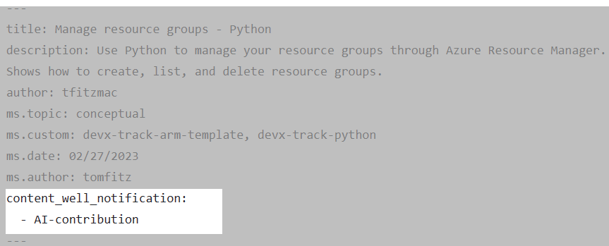
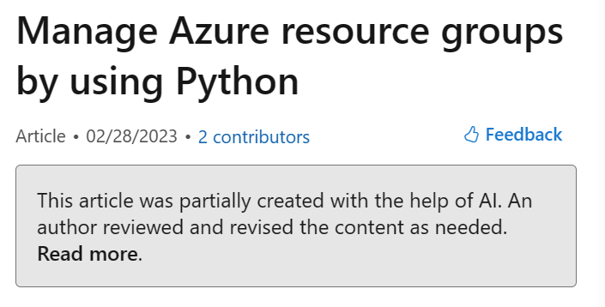
If you use AI to author content for Learn
AI-generated content | CG
Approved technology:
Azure OpenAI Service
GitHub Copilot
Not approved:
Bing Chat (The New Bing), ChatGPT, and other models available externally through OpenAI.
Example already live:
Manage resource groups - Python - Azure Resource Manager | Microsoft Learn
Notes:
Speaking of credit, some important news here.
If you use approved AI to write content, and there are approved AI services to use and some not approved, we need to add a metadata tag to the article to properly and ethically acknowledge this. This is already live in public and is not optional. The top link there is the Contributor Guide link to Publish AI-generated content and code samples.

Slide 61
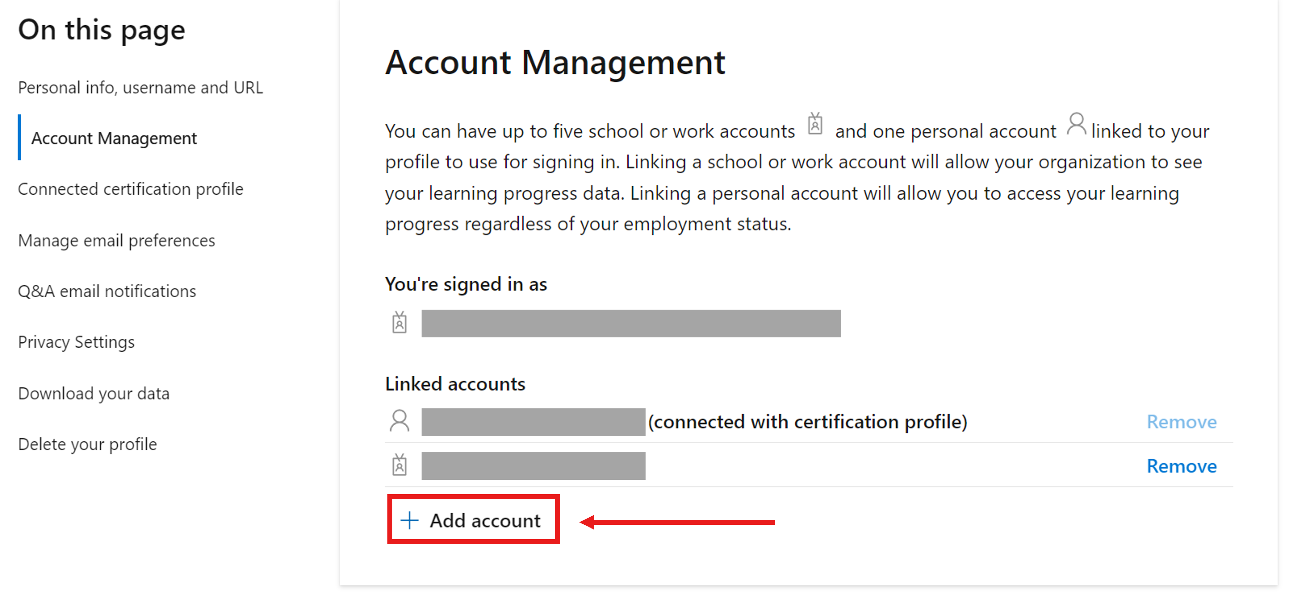
Multiple accounts -> Learn profile
You can have up to five school or work accounts and one personal Learn account.
Your Learn profile can serve as a digital resume and proof of skills.
Notes:
<read notes instead>
In this way your Learn profile can serve as a digital resume and proof of skills.
In Learn, select the profile icon in the top, right corner, Select Setting, and Account Management.
More: https://learn.microsoft.com/en-us/training/support/learn-profile-manage

Slide 62
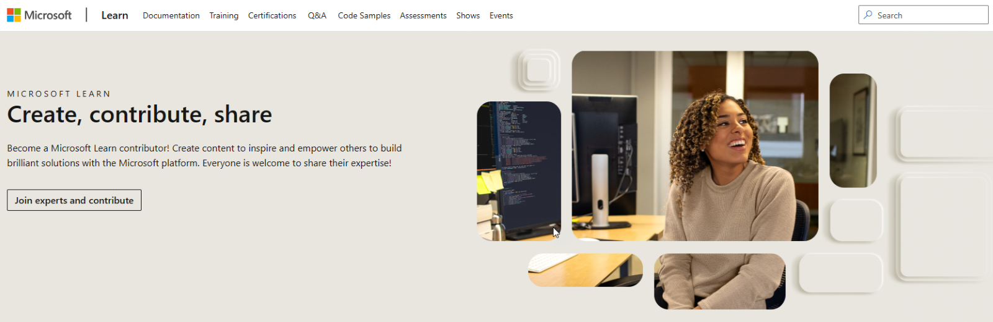
Contributor Home
Home: learn.microsoft.com/contribute/
Your profile: learn.microsoft.com/users/me
Notes:
<read notes instead>
If you haven’t already noticed, Microsoft has a new Contributor Home to go along with your Learn profile page.
The new Contributor Home page includes a new design that has clear calls to action for contribution and connection options, and an FAQ for contributors.
It shows off our contributor showcase, currently featuring stories from external contributors.
The profile page puts your Learn, certs, Q&A, Docs collections and more together in one place, including auto-detection of your account in certifications, exams, instructor-led training (ILT) details, and more.
You can get a transcript of your Learn modules completed, exams, and historical certs. Share with a secure link.
You can also connect your Pearson VUE certification profile and get notifications for certification renewals, and more, and link directly to Pearson VUE to schedule the exams you’re pursuing.

Slide 63
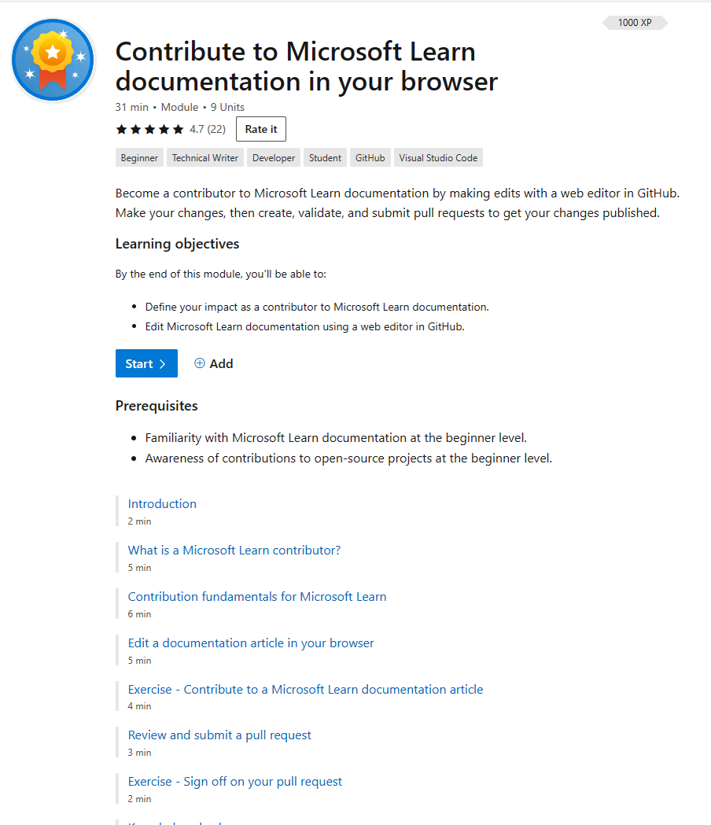
New Learn module on Contributing
“Contribute to Microsoft Learn documentation in your browser”
Module: Contribute to Microsoft Learn documentation in your browser
Notes:
One of the things highlighted in the new Contributor home page is the new Learn Module to help you get started, covering much of what we’ve covered today, but in the Learn training module format. Introduced in July 2023. This 9 unit Learn module has a knowledge check and an exercise to get you rolling with contributions. We estimate this module takes about 30 minutes to complete, and includes GitHub contribution fundamentals, and how to edit a published article via a web editor in GitHub.

Slide 64
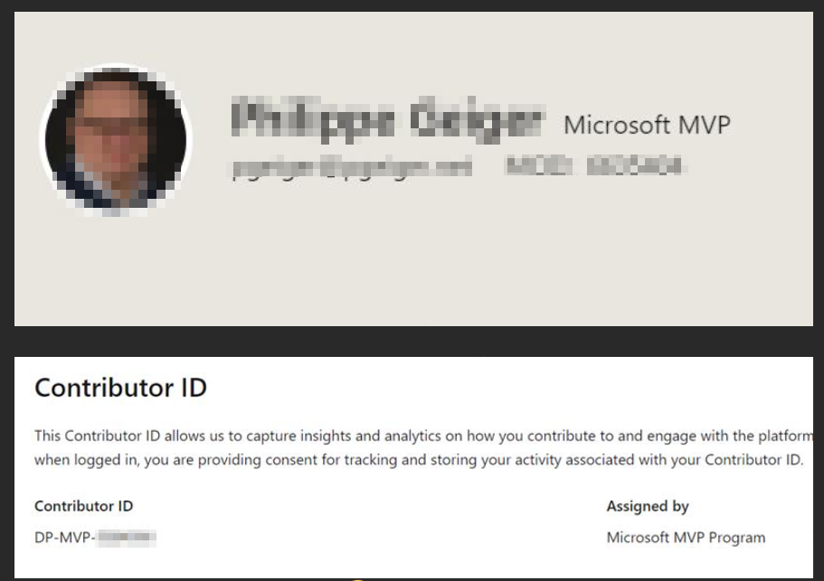
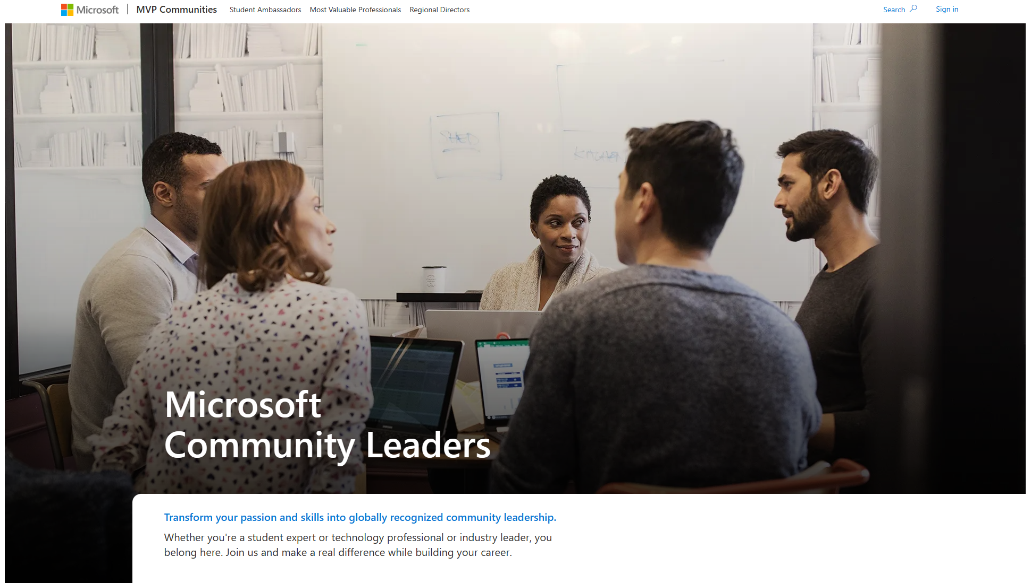
New MVP Website + Tags on Learn
Along with the new MVP Communities site for MVPs, you’ll find Microsoft MVP tags on your Microsoft Learn profiles.
Notes:
MVPs are recognized on Microsoft Learn automatically when they use the same Microsoft Identity account as in the MVP site, helping them stand out and be recognized when they interact in Microsoft Q&A, for example.

Slide 65
MVPs: Docs and Learn Champion
MVP creator ID’s for links to Learn and Docs content
Ex: https://learn.microsoft.com/azure/azure-sql/virtual-machines/windows/sql-server-iaas-agent-extension-automate-management?WT.mc_id=DP-MVP-5003697
1000+ MVPs are registered to participate
Works also for sites: azure.microsoft.com, learn.microsoft.com, cloudblogs.microsoft.com, and many more Microsoft sites.
Contact skillingchampion@microsoft.com to sign up.
Edge extension: https://microsoftedge.microsoft.com/addons/detail/skilling-champion-extensi/fmbcbeaecledoacfmelbailimfbcjpkb
Notes:
<optional slide for MVPs>
For MVPs, the Docs and Learn Champion program gives you a unique code to append to links to Microsoft Learn and Docs content in your blogs and social media. This is a WebTrends code that can be appended to links to help measure referrals from your content.
As a participant, you have the option to get a personalized report of your contribution analysis as part of the program, contact your MVP Program Manager for more information.

Slide 66
Q&A

